Slide 1


Sustainability @ Avient
Material Science for a Better Tomorrow

Slide 2

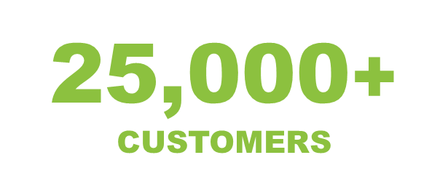
Avient: Who We Are
Headquartered in Avon Lake, OH (Cleveland)
100+ manufacturing plants
Key Financial Data
2022 Sales | $3.6 billion
2022 EBITDA | $592 million
2022 EPS | $3.04
36
40
23
35,000+
SOLUTIONS
9
9,300+
ASSOCIATES
U.S. and Canada
Latin America
Europe, Middle East & Africa
Asia

Slide 3
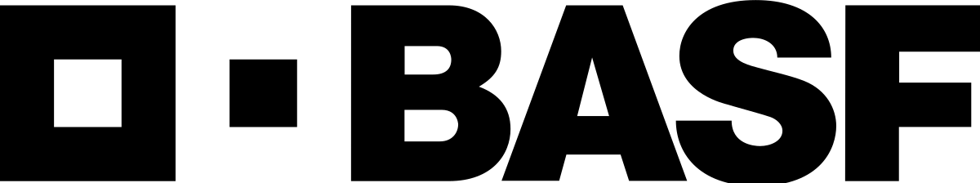


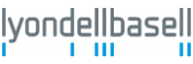
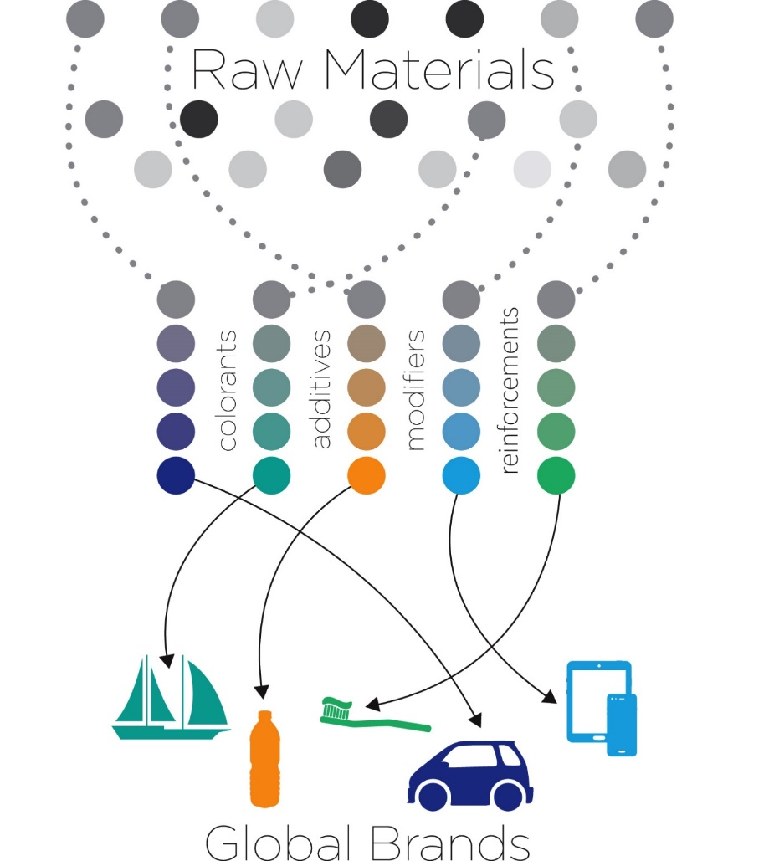




We are a formulator
CUSTOM
FORMULATION

Slide 4
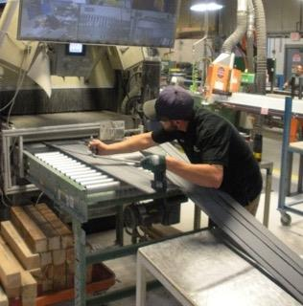



SUSTAINABILITY
OUR MISSION
Enable our customers’ innovation and sustainability goals through world class products and services AND excellence in the four cornerstones of:
People
Products
Planet
Performance

Slide 5








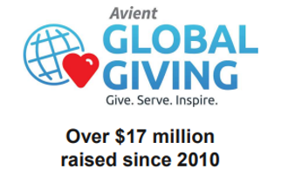
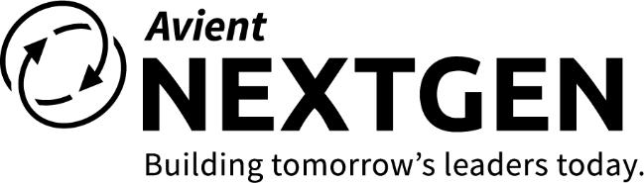


People
Culture is everything
World-Class Safety
Diversity & Inclusion
6x Safer
than Industry Average
Community Service
Leadership Development
Notes:
At Avient, we believe that culture is everything!
We have invested in our culture, and its paying off.
We once again achieved world class Safety performance in 2020, achieving 7x the industry average
We have made diversity & inclusion a priority, and our associates have responded by forming a number of employee resource groups,
We recently received a 100% Equality index rating from the Human Rights Campaign based on our D&I efforts
And we were once again distinguished with the Great Place To Work certification in 2021, a real testament to our investment in our culture.
So this is a real focus for us…. And we are Very Proud of our achievements here.
The way I look at it, and many studies have shown, that…. more sustainable companies attract and retain talent better, and therefore perform better.

Slide 6
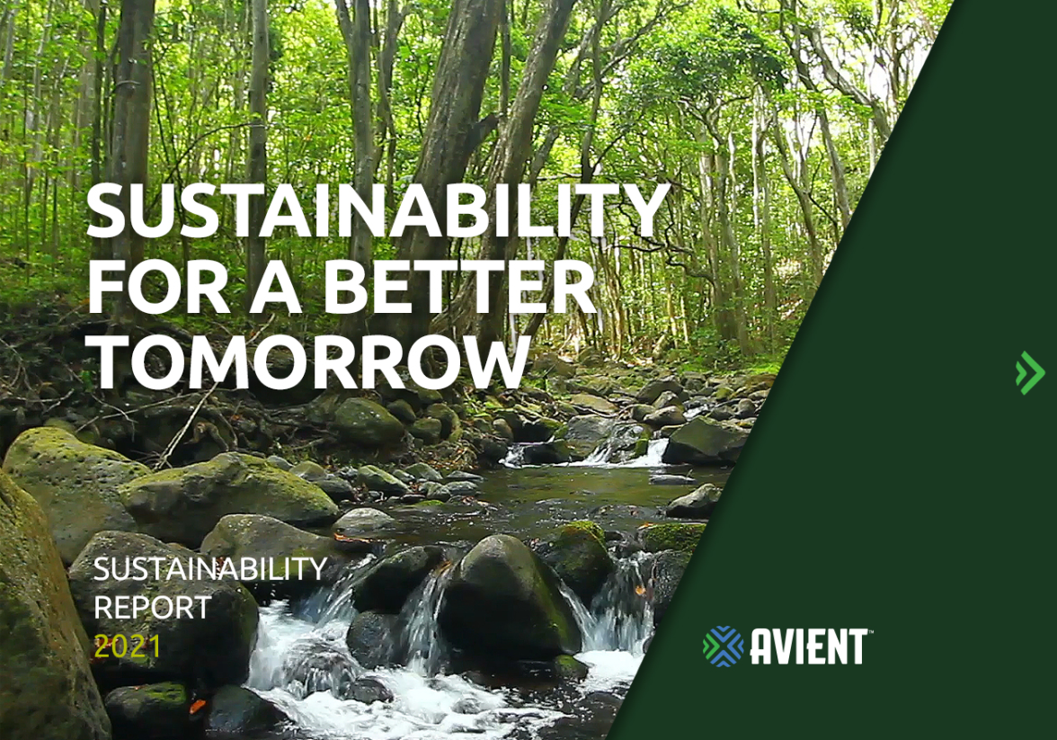

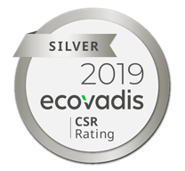

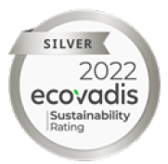

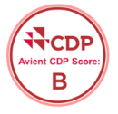

Continuous ESG Improvement
Annual Sustainability Report
U.N. Global Compact Alignment
Updated 2030 Sustainability Goals
Further disclosure on key Environmental, Social, and Governance impacts
Climate change commitment, including 2050 net zero commitment.
6

Slide 7


Avient Sustainability Targets
Enable 100% of products manufactured for packaging applications to be recyclable or reusable.
Obtain 60% of electricity demand from renewable sources by 2030, and 100% by 2050.
Deliver cumulative annual revenue growth from our Sustainable Solutions portfolio of 8–12%.
Assess top 90% of supplier spend for alignment with Avient Sustainability objectives.
Reduce Scope 1 & 2 greenhouse gas emissions by 60% by 2030, and net zero by 2050.
Develop and implement solutions to end plastic waste while supporting AEPW $1.5B investment in key initiatives.
Reduce waste to landfill by 35%.

Slide 8
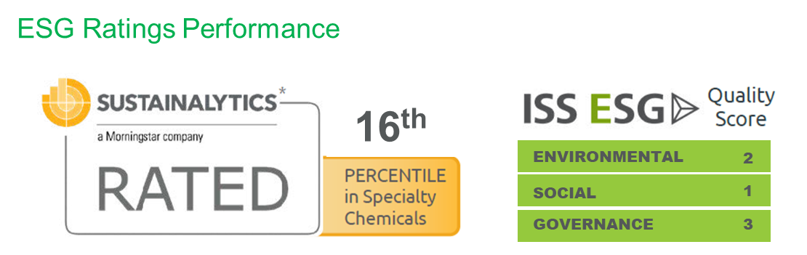
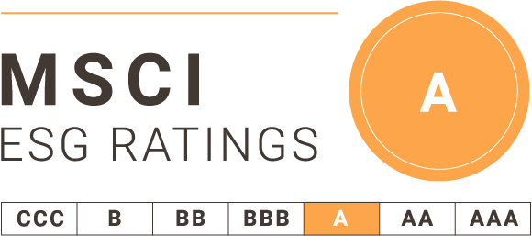
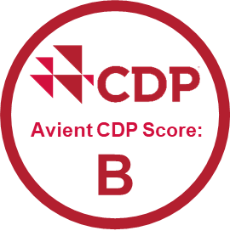
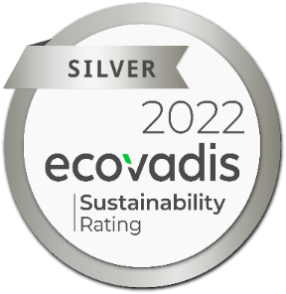

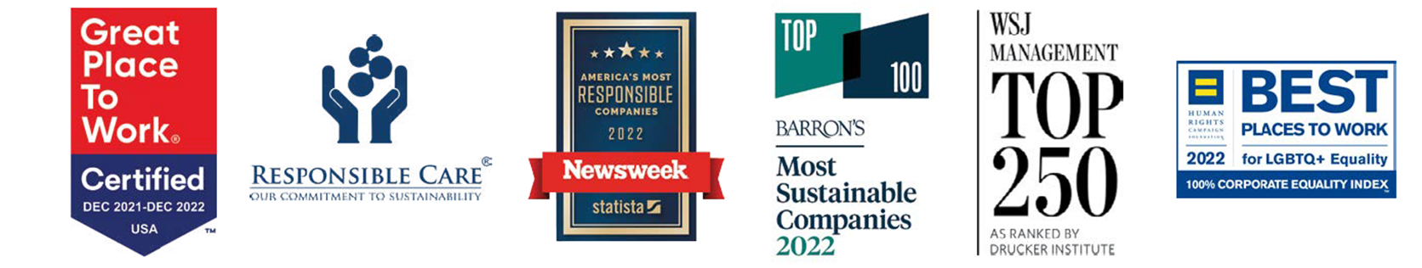
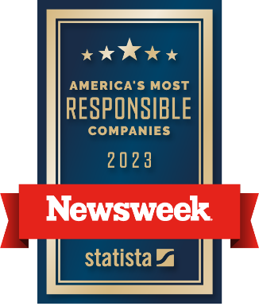
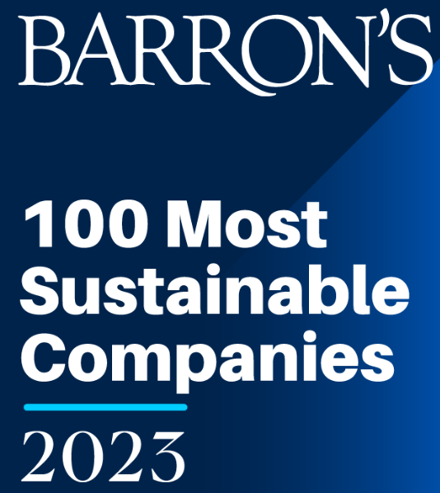
ESG PERFORMANCE & Awards
ESG Ratings Performance
65/100
90th
^{percentile}
ESG Awards and Certifications
Notes:
And ESG rankings and ratings firms have taken notice….
Very proud of these ratings of course, but what we’re most excited about is sustainability drives growth for our company…

Slide 9

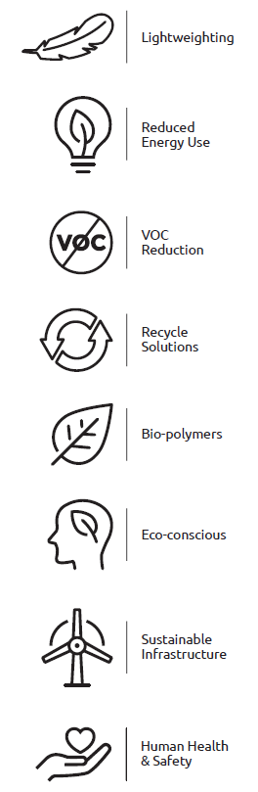
products
8 WAYS WE HELP Customers
BE MORE SUSTAINABLE
9
Notes:
Clearly one of the best ways we can drive growth for us and our customers is through “innovation that enables their sustainability goals”. We categorized our sustainable solutions portfolio by the 8 ways we help customers be more sustainable.
From lightweighting to reduce carbon emissions, to enabling sustainable infrastructure, or helping them to increase recyclability.
Our customers count on Avient to help them reach their commitments.
Now I’m going to show examples of our top 3 categories….

Slide 10
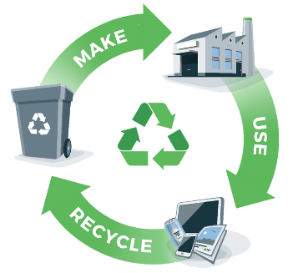
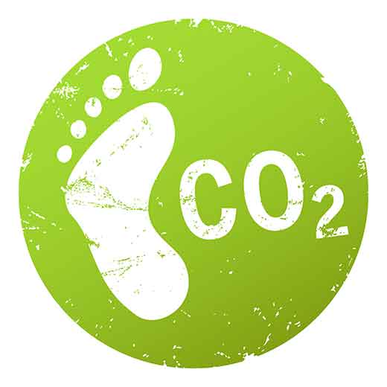
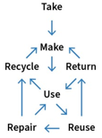
Three Areas of Focus
Recycle Solutions
Improving Recycled Content
Eco Conscience
Reduced Product Carbon Footprint
Development innovation
Multi-pass development capabilities

Slide 11

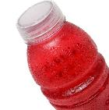
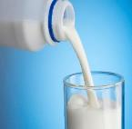


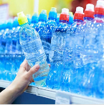
SUSTAINABLE SOLUTIONS for the circular economy
OPTICA™ TONERS FOR PET
rPET ENHANCEMENT SOLUTIONS
JOULE™ & SMARTHEAT™ INFRARED ABSORBER
ANTIHYDOLYSIS SOLUTIONS FOR EXTENDED PET FIBER LIFE
REJOIN™ 100% PCR MASTERBATCHES for Olefins and PET
IR SORTABLE BLACK FOR RECYCLABLE Solutions
Rheology Modification for Olefins
THERMAL STABILIZATION PACKAGES

Slide 12
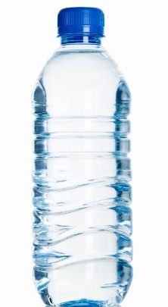
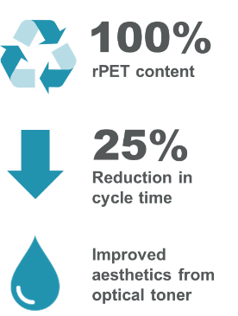
AVIENT ENABLEs CUSTOMERS’ circular economy GOALS
COLORMATRIX PROCESS AID & TONER FOR RECYCLED PET

Slide 13
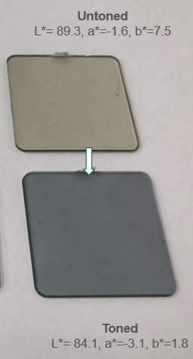
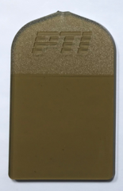
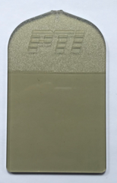
rPET Enhancement Concept
Today’s Colour Solution – Toners
Acceptable b* but also decreases L*
Colour masking effect
No impact on NIAS
Proposed Solution – Coating or Additive
Reduction in b* and Increases L*
Prevention of colour formation
Reduced NIAS
Untreated
L*=69.16, b*=25.08
db* = -5.7
dL* = -5.2
db* = -11.9
dL* = +10.1
Treated
L*=79.46, b*=13.14

Slide 14

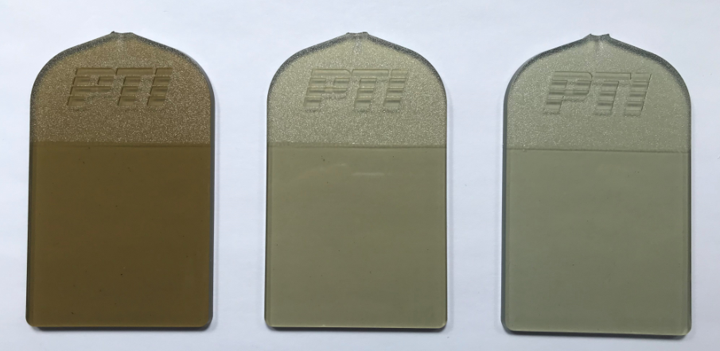
rPET Enhancement
Option 1;
An additional process carried out after washing:
A spray or submersion coating
Option 2:;
An additive solution dosed at the throat of the extruder
SSP
Washed &
Dried Flakes
Extrusion
Flake Treatment
Impact on plaque colour
Treated
Compound A
Treated
Compound B
Untreated

Slide 15

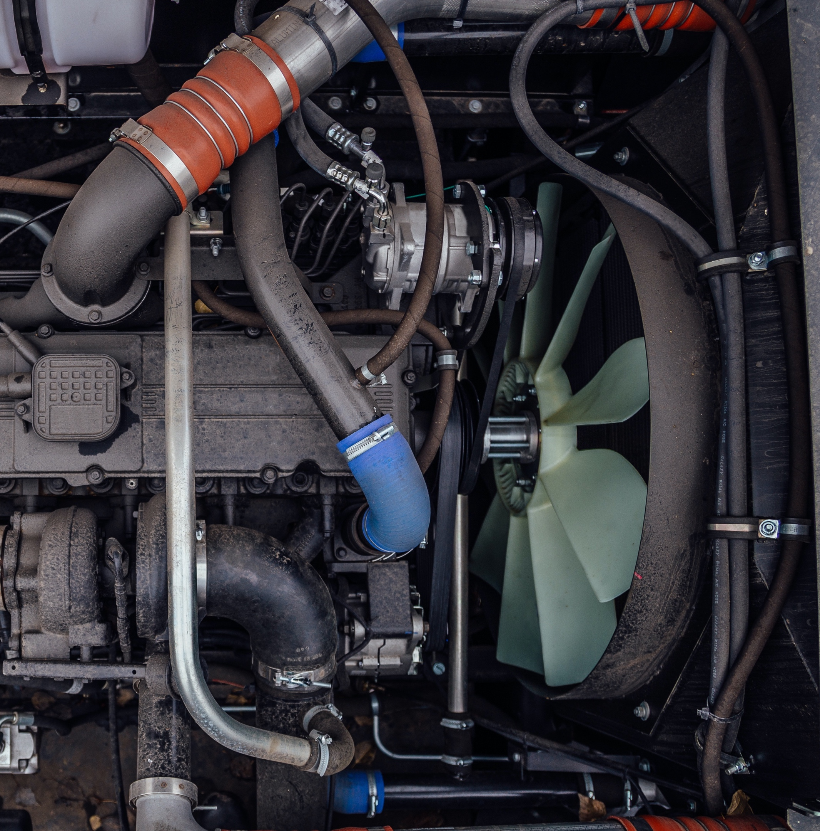

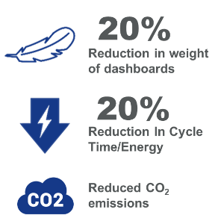



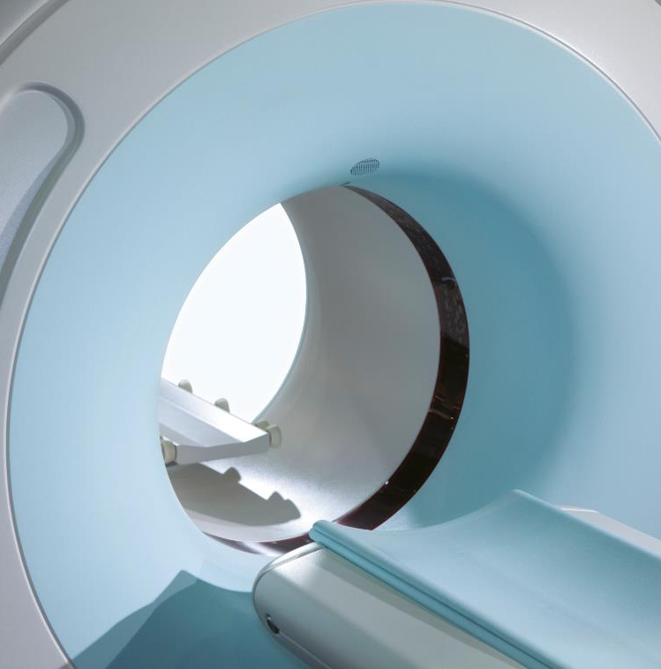
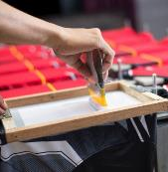
Eco-conscious
WHAT’S HAPPENING
AVIENT SOLUTIONS
SAFER & CLEANER MATERIALS
REDUCED CARBON FOOTPRINT
MAGIQ™ FIBER COLORANTS & ADDITIVES
SUATINABLE BLACK SOLUTIONS
RESOURCE CONSERVATION
ECO-CONSCIOUS ALTERNATIVES
WITHSTAND ANTIMICROBIALS
ZODIAC™ AQUARIUS™ WATER BASED
SCREEN PRINTING INKS

Slide 16
Eco Conscience Solutions for Lower Carbon Footprint
SOLUTION DYED FIBERS
ONCOLOR BIO– COLOR AND ADDITIVES FOR PHA, PLA, PHB etc
ONCOLOR™ NATURALS – COLORANTS FOR RECYCLABLE PACKAGING
RenoL™ SPIN DYE COLORING METHOD
REJOIN™ 100% PCR MASTERBATCHES FOR OLEFINS AND PET
Sustainable Carbon Black Solutions

Slide 17
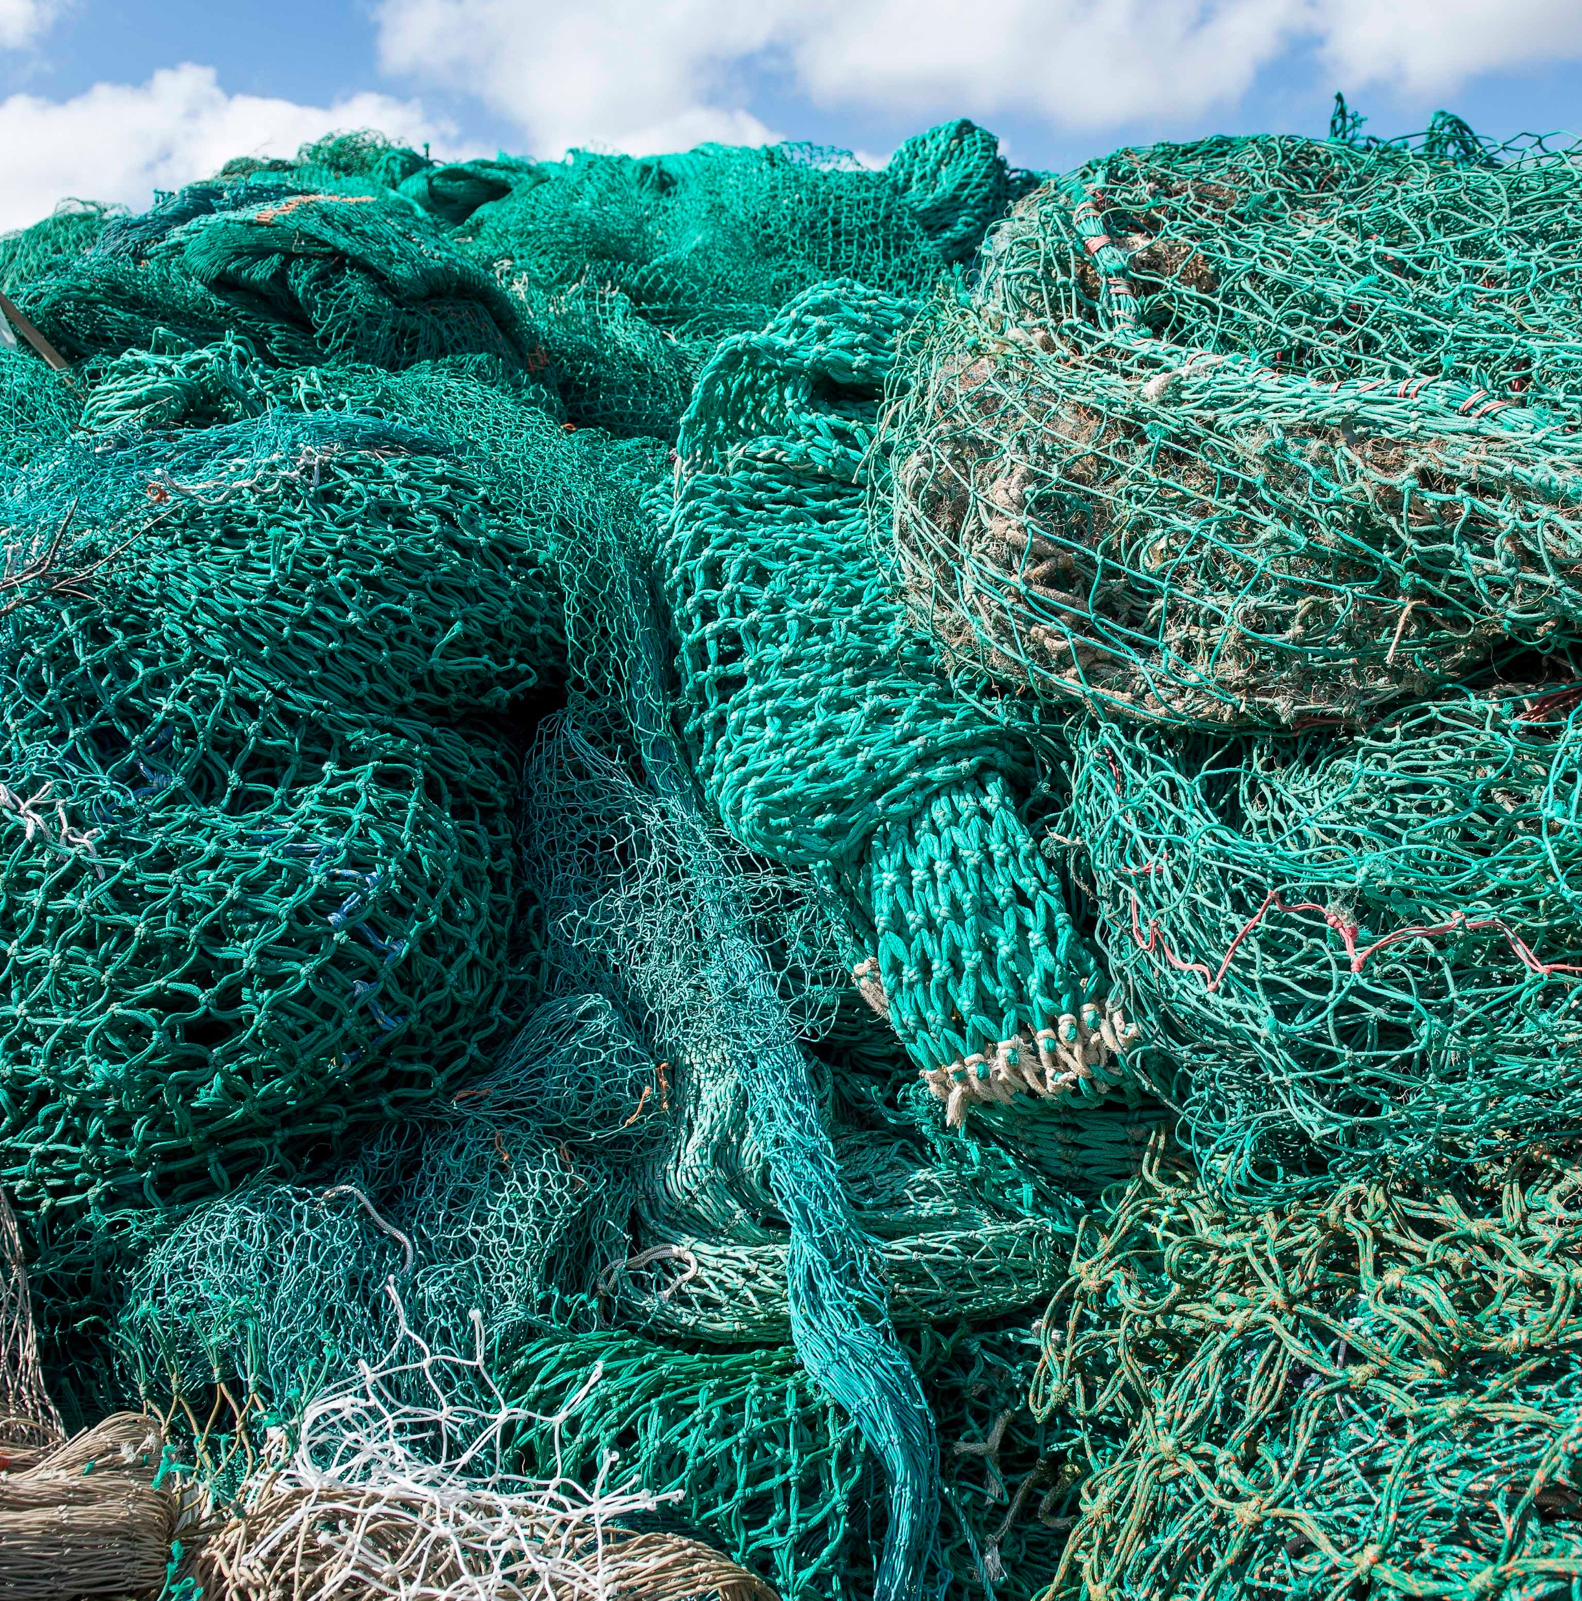

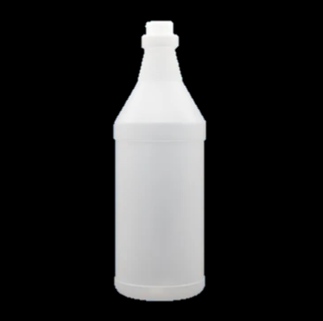
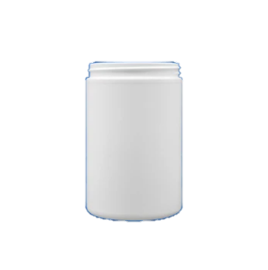

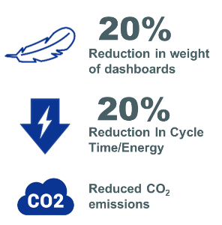
Utilizing Ocean Plastic for a More Circular Economy
REJOIN™ 100% PCR MASTERBATCHES
25-40% recycled content
Reduced plastic waste
Reduced CO₂ emissions

Slide 18



Avient enables customer to CONSERVE RESOURCES, reduce waste
RenoL™ SPIN DYE COLORING METHOD
75%
less water
30%
less energy
25%
lower carbon footprint
Notes:
In one other example, we enabled a more eco-conscious process by developing a solution that allowed our customer to directly color the fiber in the spin dyeing process while it is being made as opposed to dipping entire uncolored garments in large vats of chemicals to do the same. The customer was able to eliminate that entire dipping process, enabling them to use……
75% less water, 30% less energy, and 25% less CO2….
Now that’s eco-conscious!

Slide 19
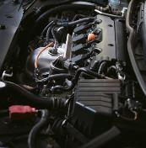
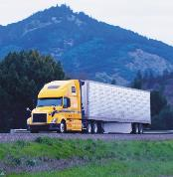
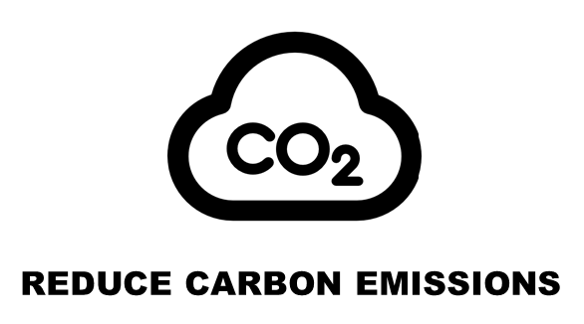
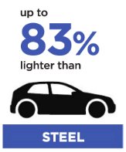

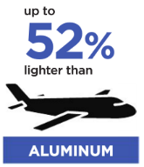
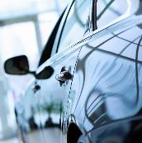

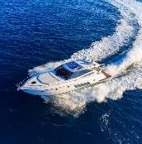

LIGHTWEIGHTING
WHAT’S HAPPENING
AVIENT SOLUTIONS
PLASTICS ARE:
COMPLĒT™ LFT THERMOPLASTIC COMPOSITES
POLYSTRAND™ TAPES AND LAMINATES
NYMAX™ NYLON FORMULATIONS
HYDROCEROL® CHEMICAL FOAMING AGENTS

Slide 20

Lightweighting
Commercial trucks
Polystrand™ Thermoplastic Composite Laminates
60%
Weight reduction in box truck panels
Improve fuel economy
100%
recyclable
Notes:
As an example, we recently helped a truck manufacturer to replace wood in their box truck with composite panels at a 60% weight reduction… this is in an application where every pound matters. In addition to weight savings, our composite panels are more durable and extends the life of the truck.
The approach in this application includes reinforcing composite laminates, something that could be of interest to you to help you lightweight your solutions.

Slide 21
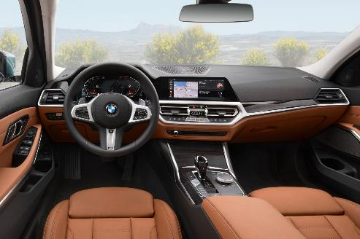
Avient solutions enable lightweight dashboards
HYDROCEroL® FOAMING AGENT SOLUTIONS

Slide 22
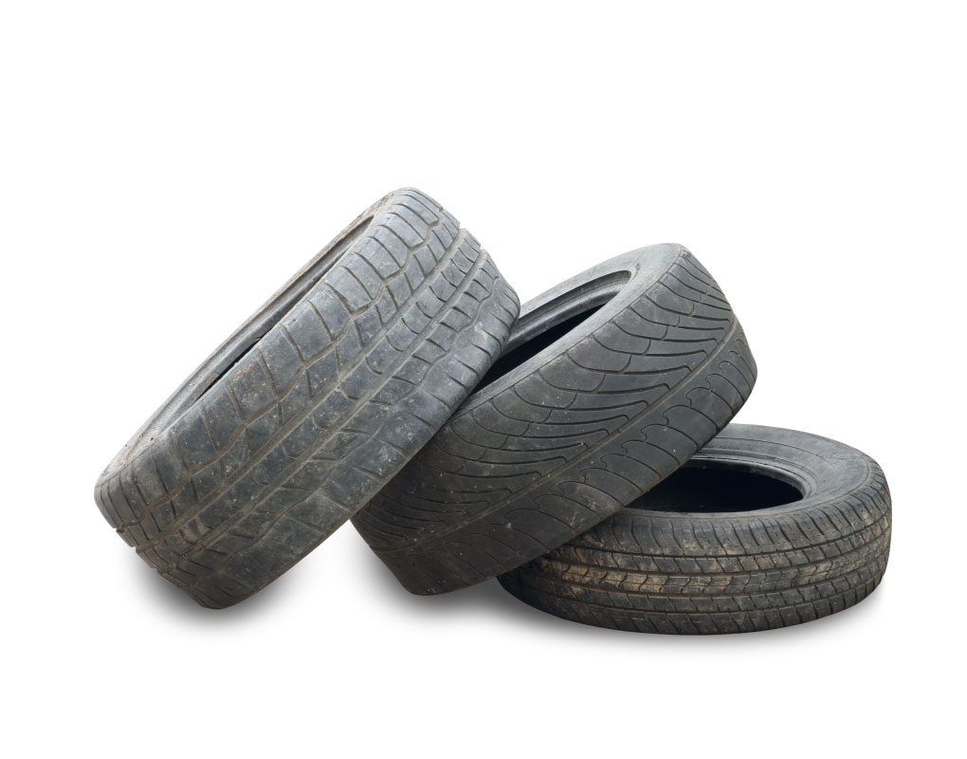
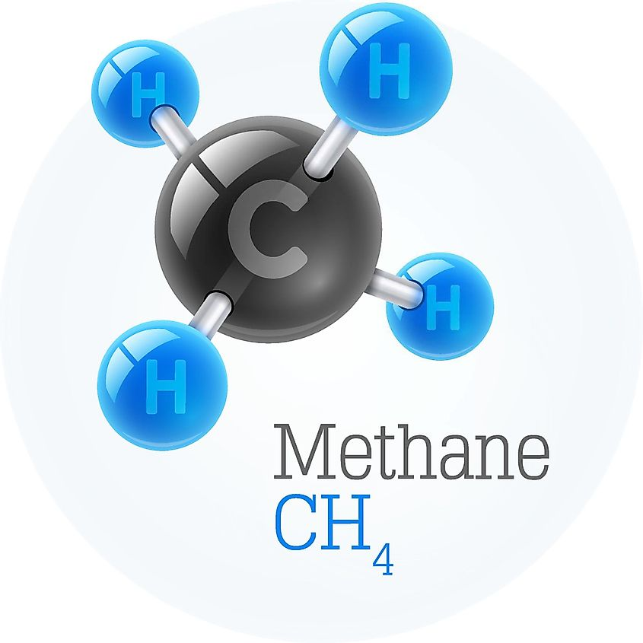
Avient enables customer to USE ALTERNATE MORE SUSTAINABLE COLORS
ONCOLOR - sustainable BLACK solutions
EQUIVALENT PERFORMANCE
PYROLYSIS BASED ON USED TIRES
30%
less energy
ALTERNATE FUEL SOURCE
35%
lower product
carbon footprint
NATURAL BASED COLORANT SOURCE
Notes:
In one other example, we enabled a more eco-conscious process by developing a solution that allowed our customer to directly color the fiber in the spin dyeing process while it is being made as opposed to dipping entire uncolored garments in large vats of chemicals to do the same. The customer was able to eliminate that entire dipping process, enabling them to use……
75% less water, 30% less energy, and 25% less CO2….
Now that’s eco-conscious!

Slide 23
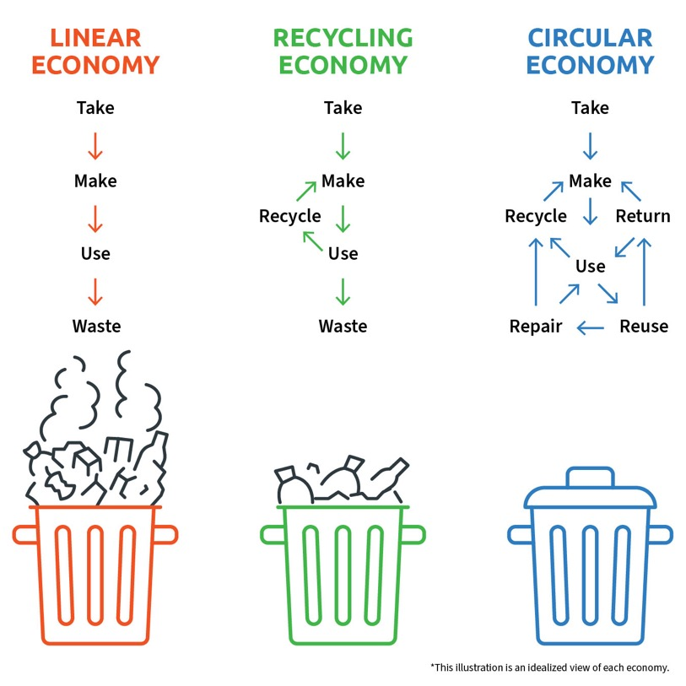
Impact of Multi-Loop Recycling
Notes:
That’s great, but, did you know not everything that you put in the recycling gets recycled.
Many issues . . .
Many people think about recycling as a one time thing, however, to make the economy truly circular it needs to happen time and time again . . .

Slide 24








Innovation for Multi-loop REcycling
Odor Scavengers
Physical Property Enhancement
Rheology Modification
Color Prediction
Polymer Stabilization
Moisture Management
SMARTBATCH™ COLOR AND ADDITIVE CONCENTRATES
Notes:
The final focus area I want to discuss is enabling sustainable infrastructure.
On the surface, infrastructure does not sound very sexy.
Yet infrastructure plays a key role in sustainable development of economies, the environment and society;… including everything from health for all… to access to energy, clean water, and safe building materials.
And we have a broad portfolio of solutions that support this trend.
From the Smartbatch Masterbatch family that enables weatherable floating solar panel fields or our Syncure wire & cable solutions that enable energy transfer in solar panel infrastructure, to…
to low smoke halogen free solutions for building infrastructure.
Fiberline also offers a Kevlar pipe rehabilitation solution that repairs metal pipe from the inside as opposed to having to scrap an entire city block or more of pipe. A really big deal.

Slide 25

Mechanical Recycling
Notes:
One cycle always works but the more cycles we do the lower the quality, so therefore we are looking forwards to building a long term sustainable system. Recycled time and time again.

Slide 26

Mechanical Recycling
How often can we turn the wheel?

Slide 27

CycleWorks™
Innovation center for plastics recycling
Real-world recycling research environment
Polymer analysis for improved recycling
Screening and evaluation of additive and colorant systems
On-site customer and circular value chain stakeholder collaboration

Slide 28

CycleWorks™
The Concept for Polyolefins & PET

Slide 29




Mechanical Recycling – Top Challenges
1
Maintaining mechanical properties
2
Contamination
3
Managing PCR aesthetics
Stable & consistent PCR quality at scale
Notes:
Identifying the gaps

Slide 30

Consistent PCR Quality
Avient
Recycler
Capabilities
Sorting and recycling
Color matching
Improving mechanical properties
Improving the processability of plastics
Understanding needs of
brand owner
Notes:
Identifying the gaps

Slide 31

SUSTAINABILITY portfolio
Revenue From Sustainable Solutions* 2016-2022
($ in millions)
$1,175M
10% Organic CAGR
Organic Future Growth Revenue Assumptions From Sustainable Solutions: 8 - 12%
*Avient Sustainable Solutions definitions aligned with FTC 2012 Guide for the Use of Environmental Marketing Claims (“Green Guides”)
**2020 is Pro Forma to include full year of the Clariant Color business
***2022 is Pro Forma for the acquisition of Dyneema and the divestiture of Distribution

Slide 32







ALLIANCES & PARTNERS
Notes:
Walter

Slide 33





Founding member
CEO-led, cross value chain
Committed to invest $1.5B over 5 years

Slide 34

Thank You

Slide 35







Human health & safety
WHAT’S HAPPENING
AVIENT TODAY
SAFER & CLEANER MATERIALS
PERSONAL PROTECTIVE EQUIPMENT
ONCOLOR™ HC PLUS
NEU™ CATHETER SOLUTIONS
STERILIZE / SINGLE USE
PERSONALIZED DRUG DELIVERY
VERSAFLEX™
THERMOPLASTIC ELASTOMERS
MEVOPUR® FUNCTIONAL ADDITIVES FOR MEDICAL

Slide 36




Avient solutions improve face mask performance
MAGIQ™ ELECTRET PLUS TECHNOLOGY
Improved
filtration efficiency
Protects
against aerosols &
bacteria particles
Increased
shelf-life

