Slide 1
Novel Additives to Improve the
Environmental Footprint of Fabric Laundering
SYFA Spring Conference 2023

Slide 2
Overview
v
  The Laundry Dilemma
  Goulston’s Background
  Goulston Tackling the Dilemma
  Wrap-Up

Slide 3
Overview
v
  The Laundry Dilemma
  Goulston’s Background
  Goulston Tackling the Dilemma
  Wrap-Up

Slide 4

Today’s Laundry Dilemma
Clothes must be washed, but at what cost?
Source: FreePik
Notes:
https://www.freepik.com/free-photos-vectors/dirty-clothes

Slide 5
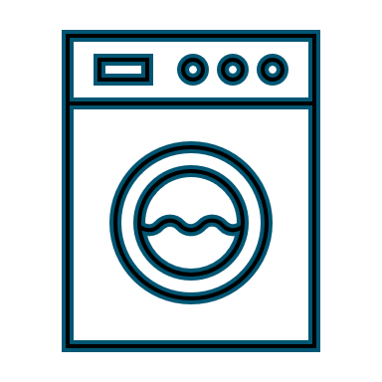


Today’s Laundry Dilemma
Energy Consumption
  675-877 kWh used on average, for home dryer by Americans annually
Microplastics
  Estimated 878 tonnes of plastic microfibers released by U.S. and Canadian home laundering annually
Garment Laundering
Sources: Arcadia, 2017, The Folde, n.d., Ellam, 2019
Energy Consumption
Microplastics into
Water Systems
Notes:
Energy Consumption:
300 loads x 2.25 kWh = 675 kWh; 390 loads x 2.25 kWh = 877.5 kWh
300-390 loads of laundry per year for Americans (P&G)
2.25 kWh per launder

Slide 6
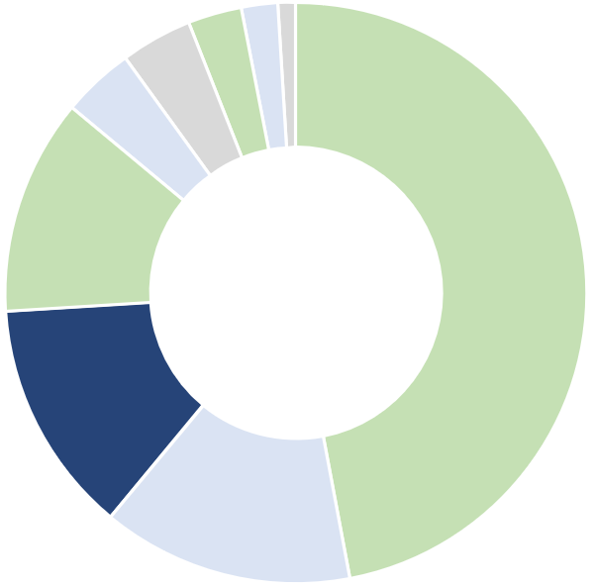
Today’s Laundry Dilemma
Water Heater
14%
Cooling & Heating
Clothes Washing & Drying
47%
Clothes Washing & Drying
13%
71% from Drying
1%
12%
Computer
Lighting
2%
4%
Dishwasher
3%
4%
Refrigerator
Sources: Taylor & Francis, 2010 and Desjardins, 2016
TV & Accessories
Electric Oven

Slide 7
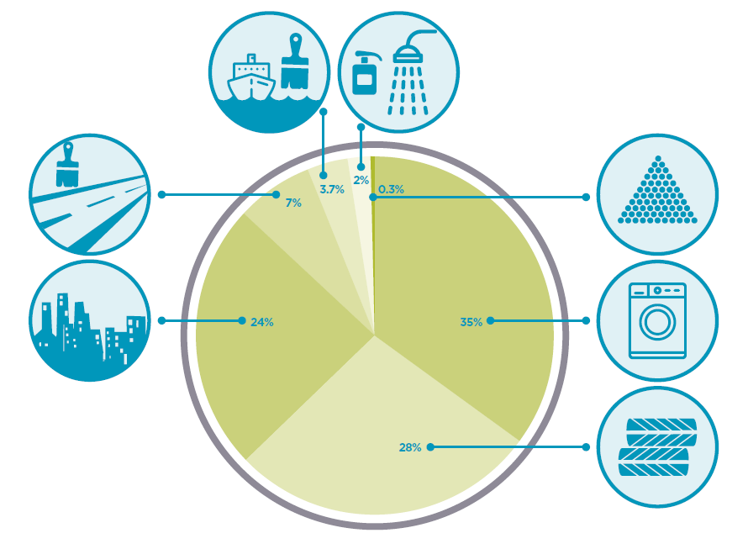
Today’s Laundry Dilemma
2%
3.7%
Marine Coatings
Personal Care Products
7%
0.3%
Road Markings
Plastic Pellets
Contribution of Microplastics to Oceans
35%
Synthetic Textiles - Laundering
24%
28%
City Dust
Vehicle Tires
Source: IUCN, 2017
Notes:
AATCC:
-Fiber fragment is <5 mm
-Microfiber has diameter <1 micron

Slide 8
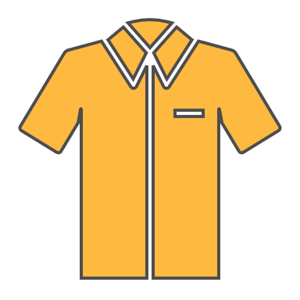

Approach to Laundry Dilemma
Reduced
Energy
Consumption
®
additives
Reduced
Microplastics into
Water Systems

Slide 9
Overview
v
  The Laundry Dilemma
  Goulston’s Background
  Goulston Tackling the Dilemma
  Wrap-Up

Slide 10
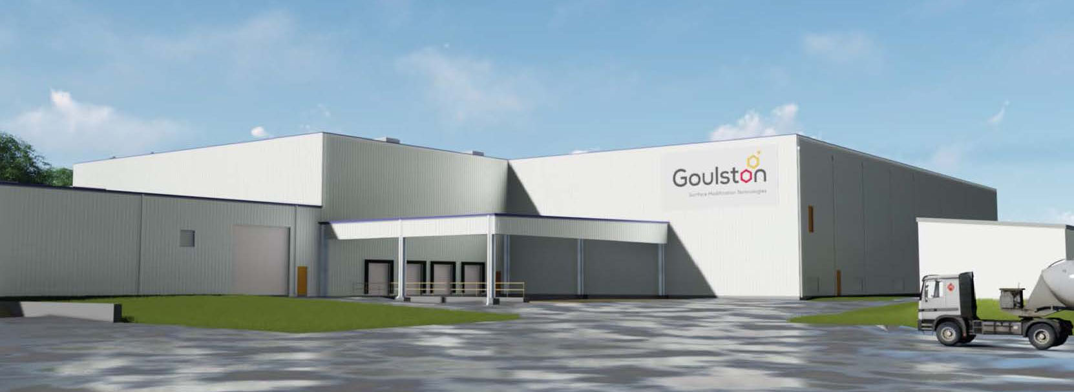

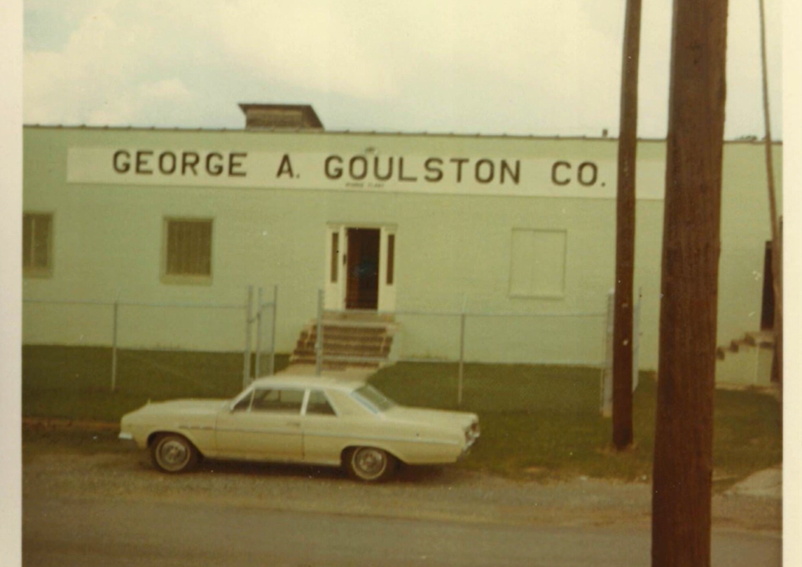


Goulston’s History
George A. Goulston Company established in Scituate, MA
Acquired by Takemoto Oil & Fat Co., LTD
Opened North Plant facility in Monroe, NC
1937
1969
1988
2014
2023
Monroe, NC facility opened
Opened first ester manufacturing facility in Monroe, NC

Slide 11
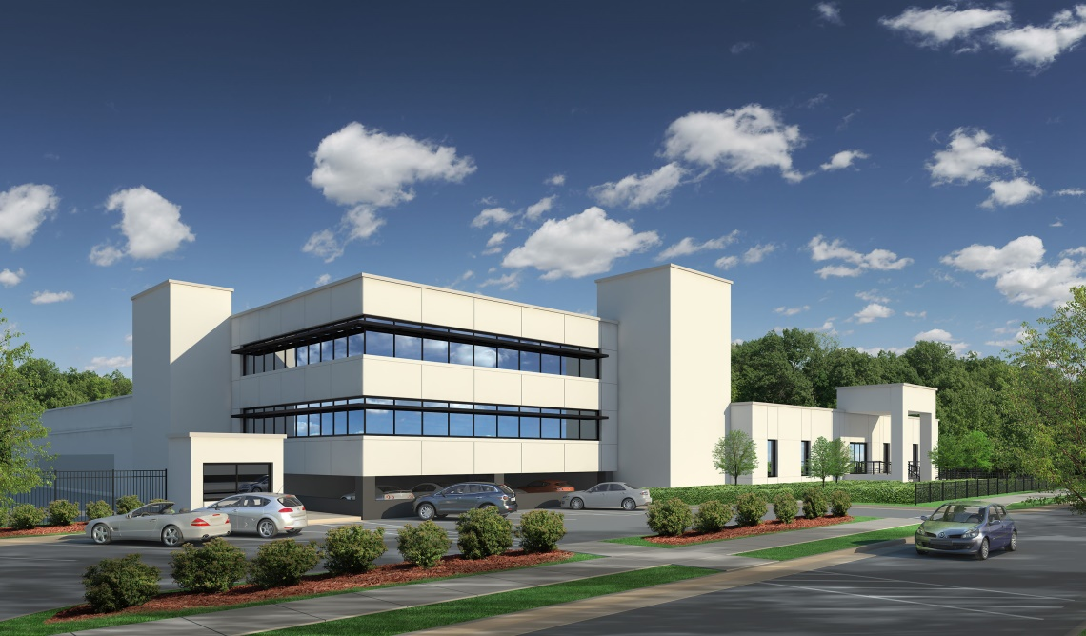
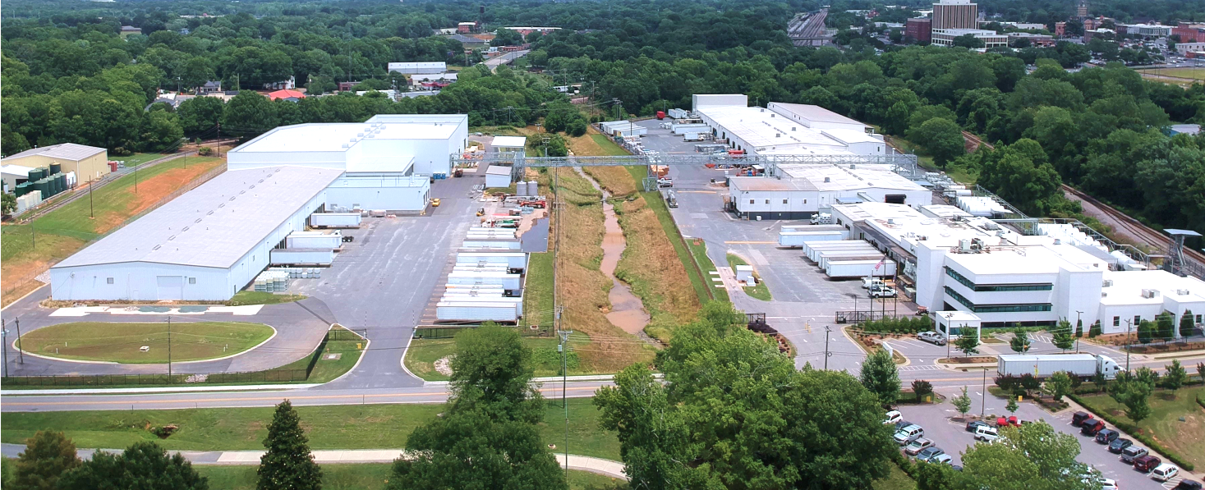
Headquarters in Monroe, NC
Centralized R&D and production on
23-acre manufacturing site
Over 300,000 ft² with over 70 mixing vessels and eight reactors
North Plant commissioned in Q1 2023, providing expanded reaction capabilities
Notes:
8 reactors, both hot oil and steam, ranging from 800 to 8,000 gallons (3-30 kiloliters)
Expanded synthesis capabilities for esters, amides, phosphates, quaternary compounds, imidazolines, betaines, and condensation polymers
North Plant provides vertical integration for Goulston while also allowing us to more efficiently develop new chemistries with scale from lab to pilot to production scale

Slide 12
Expertise in Surface Modification
Core Areas
  Spandex
  Carpet
  Textile filament
  Industrial filament
  Staple fibers & nonwovens
  Polymer additives
  Plastic films
  Antimicrobials
  Laundry aids
Emerging Technologies
  Specialty polymers
  Conductive fibers and additives
  Cosmetic additives

Slide 13
Expertise in Surface Modification
In-depth understanding of surface interactions
What is a surface?
  Interaction between two phases
    Solid-liquid
    Liquid-gas
    Solid-gas

Slide 14

Expertise in Surface Modification
In-depth understanding of surface interactions
What is a surface?
  Interaction between two phases
    Solid-liquid
    Liquid-gas
    Solid-gas
Surface modifications change the way surfaces behave

Slide 15

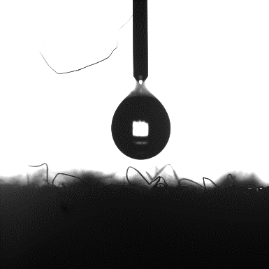
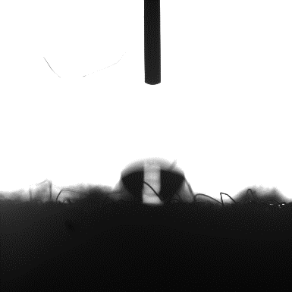

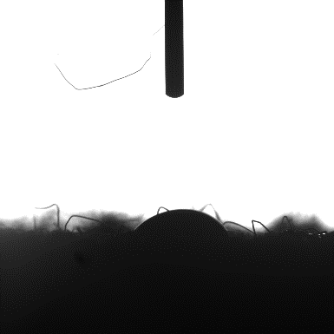

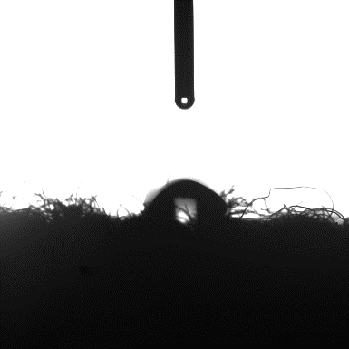

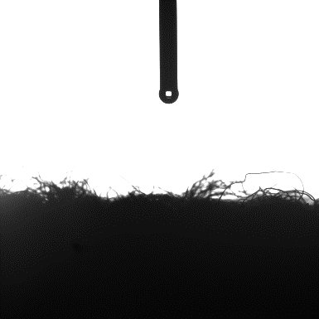
Expertise in Surface Modification
A fiber finish is a coating which provides specific properties to the fiber surface that:
  Improves the fiber manufacturing process
  Improves downstream performance
  Provides desired end-use properties
  Provides added value to the fiber, fabric, and/or garment
Source: Ecotextile

Slide 16
Overview
v
  The Laundry Dilemma
  Goulston’s Background
  Goulston Tackling the Dilemma
  Wrap-Up

Slide 17
DryFast® Additives
Manages Moisture Transport
Anchors to Filaments
Protects Filaments

Slide 18
DryFast® Additives

Slide 19

DryFast® Additives
Manages Moisture Transport
Reduces dry time
Reduces energy consumption

Slide 20
DryFast® Additives

Slide 21
DryFast® Additives
Protects Filaments
Reduces shedding
Reduces microfiber release in water systems
Notes:
AATCC:
-Fiber fragment is <5 mm
-Microfiber has diameter <1 micron

Slide 22
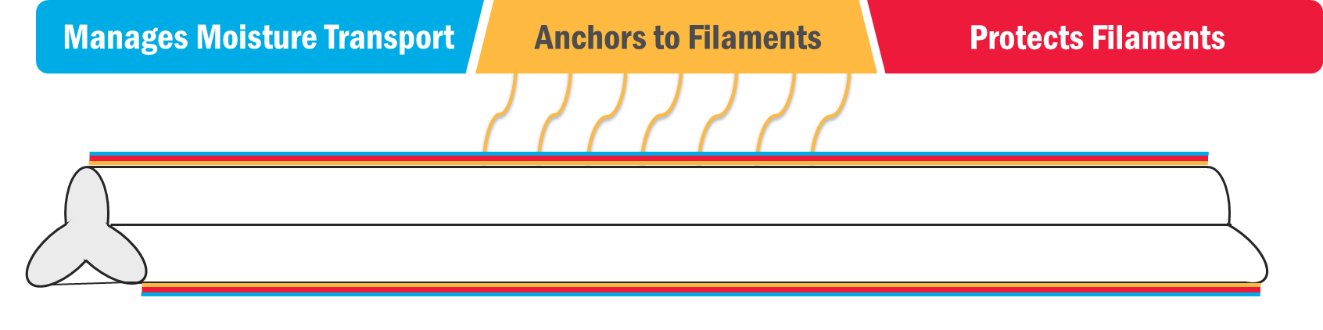
DryFast® Additives
Chemistry Application
In-Process
(Ex. Coning Oil Step)
Final Stage
(Ex. Dyeing / Finishing)
Post Treatment
(Ex. Laundering)

Slide 23
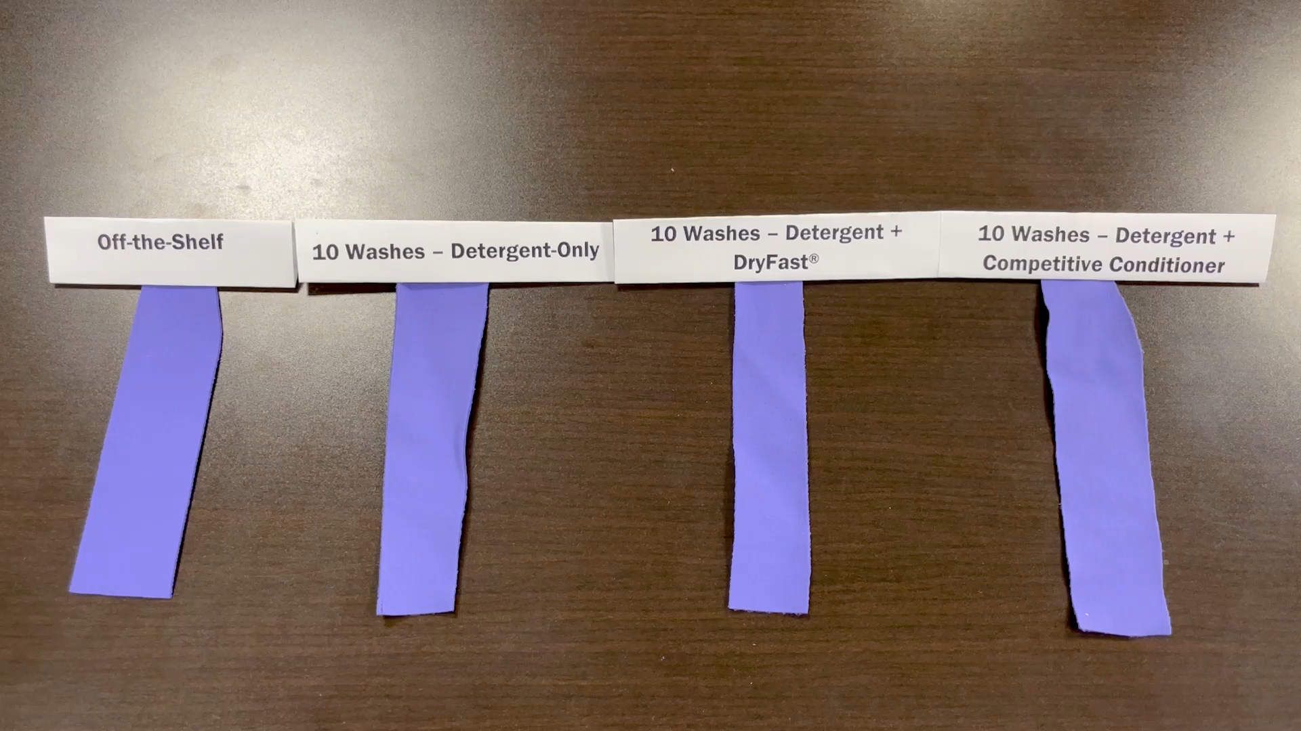
Moisture Management Approach
Manages Moisture Transport
Notes:
When washing garments, particularly activewear, with standard home laundry detergent (Tide), wicking properties are lost. Incorporating DryFast® with detergent (on its own or added to the detergent formulation) will preserve the garment’s wicking performance provided when worn off-the-shelf or restore wicking performance once its lost. DryFast® functions by moving moisture outward to form a thin wet layer, taking less energy to allow the moisture to evaporate and the garment to dry.
Most activewear and synthetic garment suppliers recommend not using fabric softeners on the garments as traditional fabric softeners are hydrophobic, bead up on the surface, and inhibit wicking. This also causes clothes to take longer to dry. DryFast® is safe to soften on all synthetics to protect wearability while protecting wicking performance.

Slide 24
Moisture Management Approach
Manages Moisture Transport
  DryFast® provides enhanced wicking
  DryFast® replenishes wicking length lost through laundering
Notes:
AATCC Test Method 195 for MMT
ASTM D1776 for conditioning (27 +/-2C, 65 +/- 5% RH)
Top layer fabric = next to skin

Slide 25
Moisture Management Approach
Manages Moisture Transport
  DryFast® restores and enhances one-way transport
  DryFast® provides enhanced overall moisture management capacity
Notes:
AATCC Test Method 195 for MMT
ASTM D1776 for conditioning (27 +/-2C, 65 +/- 5% RH)
Top layer fabric = next to skin

Slide 26
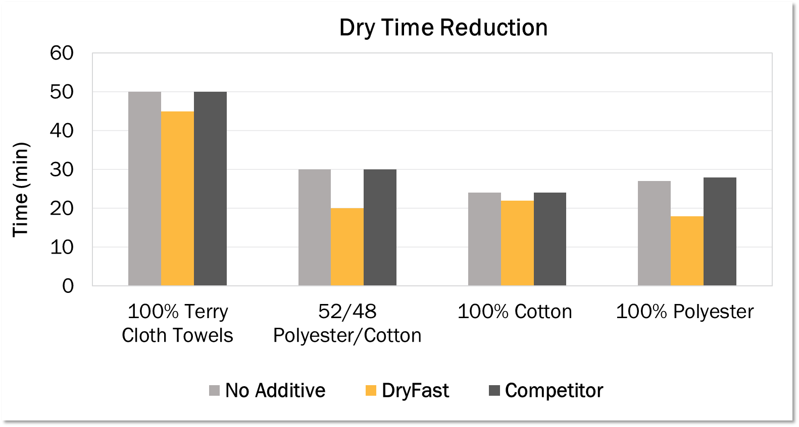
Moisture Management Approach
Manages Moisture Transport
-10%
  8-33% reductions in dry time using DryFast® additives in home dryer
  Performance improved with synthetics
-33%
-33%
-8%
Notes:
Samples:
100% Terry cloth towels
52/48 Polyester/Cotton sheets
100% Cotton sheets
100% Polyester wipes

Slide 27
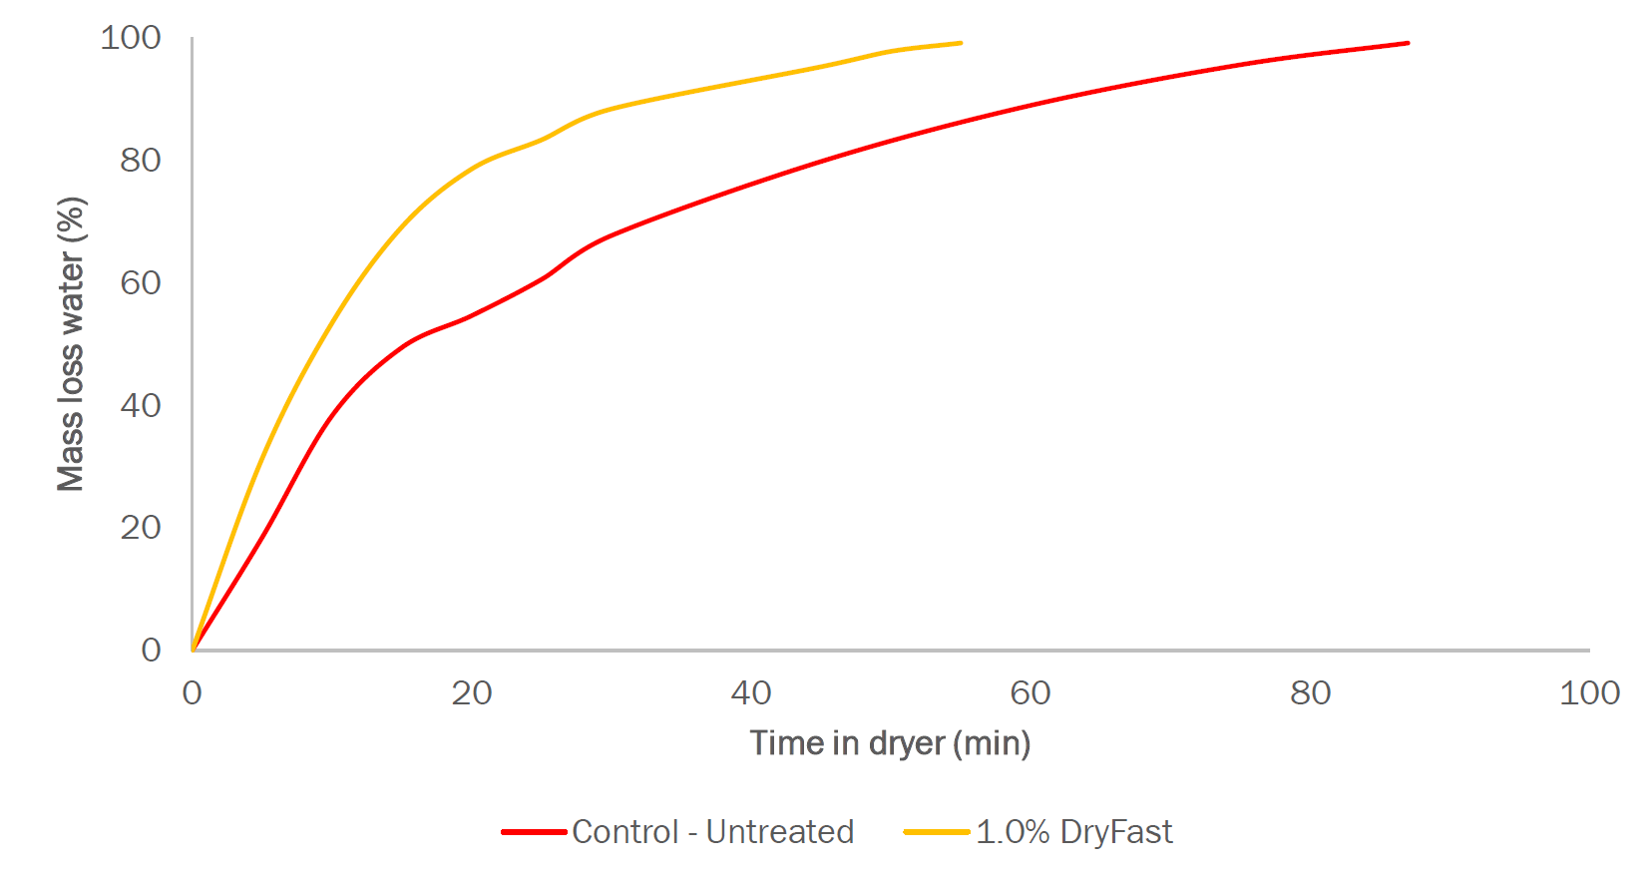
Moisture Management Approach
Manages Moisture Transport
100
100% Dry
-37%
  37% reduction in dry time using DryFast® additives
  At 55 minutes,
    Untreated 82% dry
    DryFast® 100% dry
  80% polyester, 20% cotton shirts used
80
82% Dry
60
Mass Loss of Water (%)
40
20
0
0
20
40
60
80
100
Time in Dryer (min)
Untreated Control
1% DryFast®
Notes:
Completed on 80/20 blend of Polyester/Cotton

Slide 28
Moisture Management Approach
Manages Moisture Transport
  DryFast® significantly enhances vertical wicking
  DryFast® imparts wash durability
®
®

Slide 29
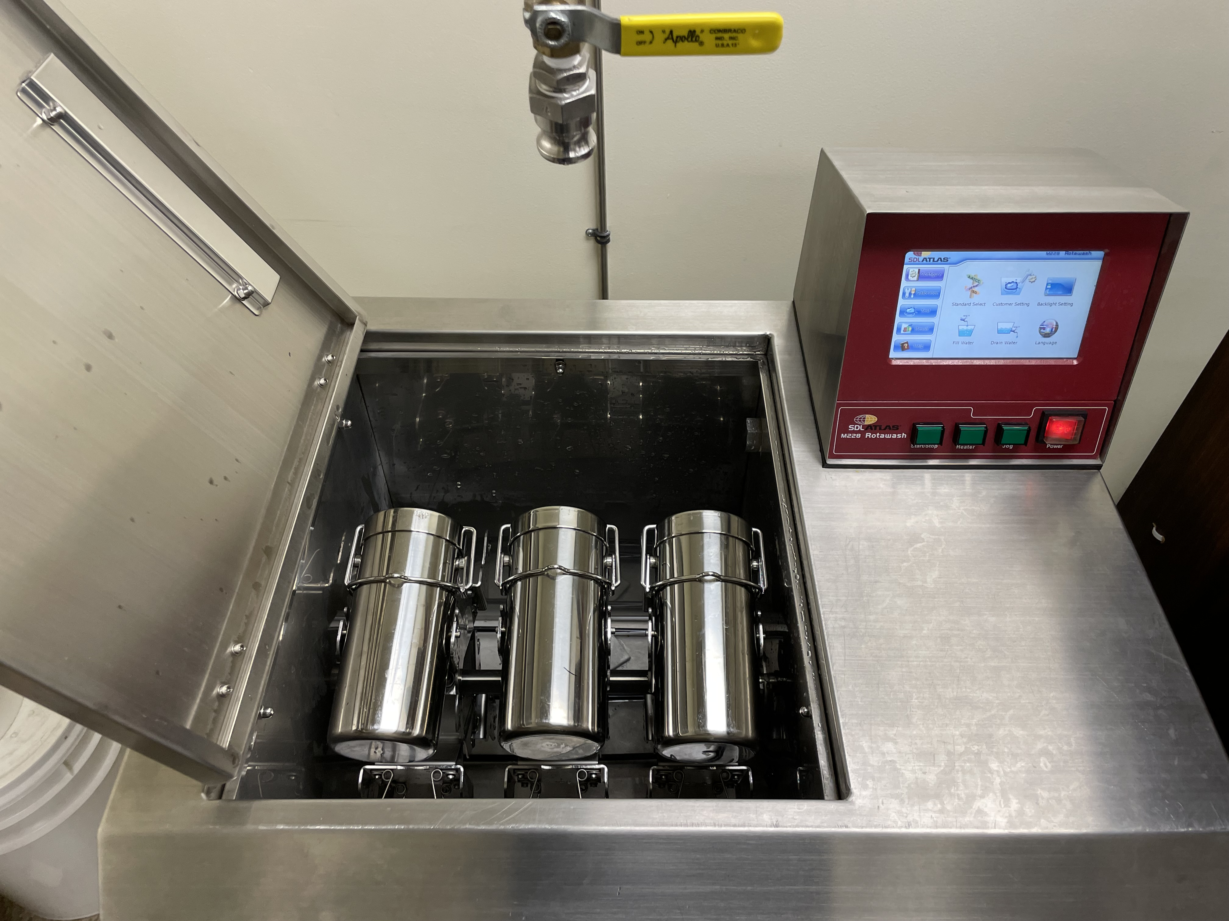
Microfiber Reduction Approach
Protects Filaments
AATCC TM212-2021
Fiber Fragment Release During Home Laundering
Washing Option B – No detergent
Drying Option B – Oven dried filters
Socks used – 98% PET / 2% Spandex

Slide 30
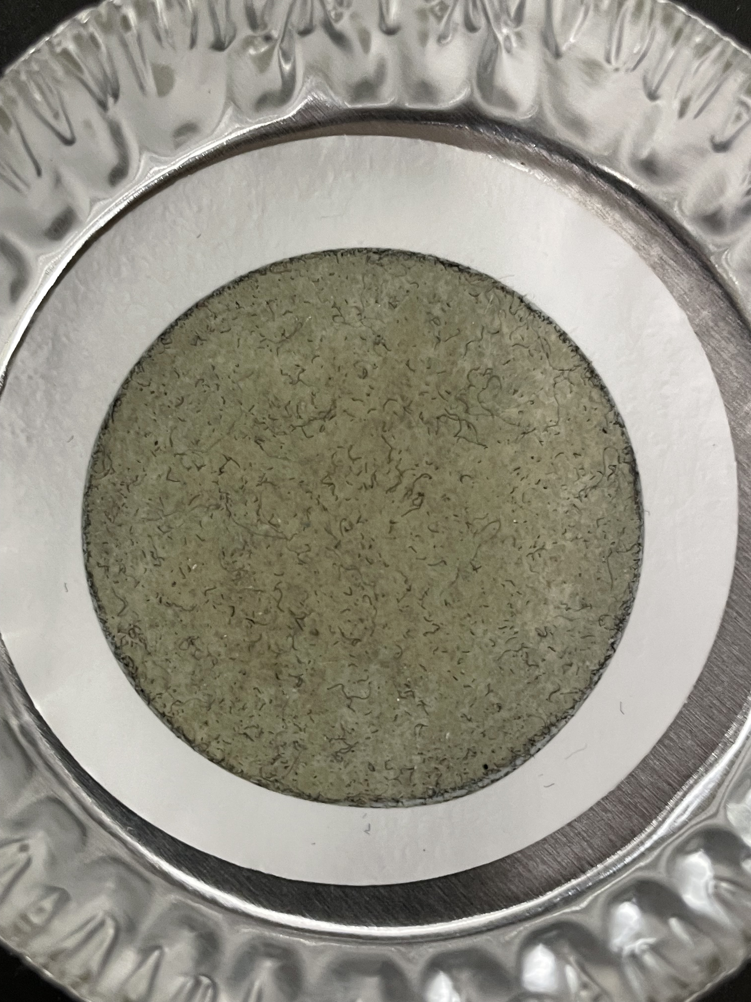
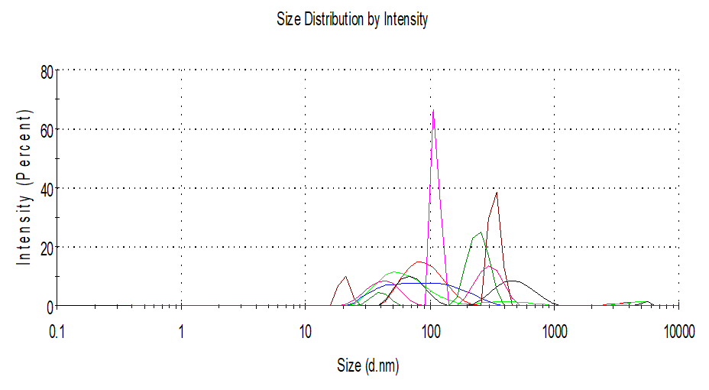
Microfiber Reduction Approach
Protects Filaments
Vacuum

Slide 31
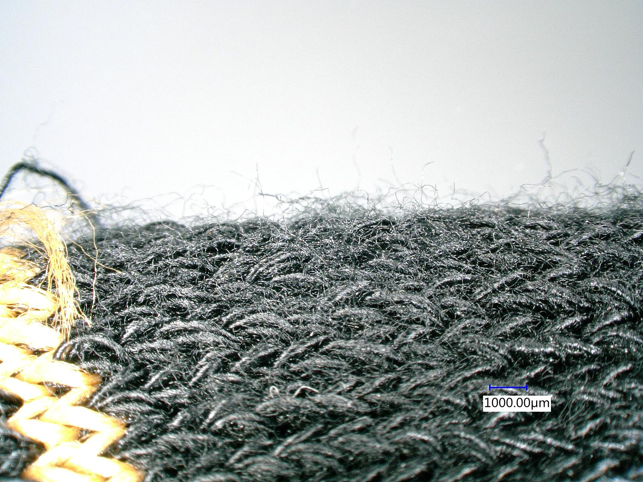
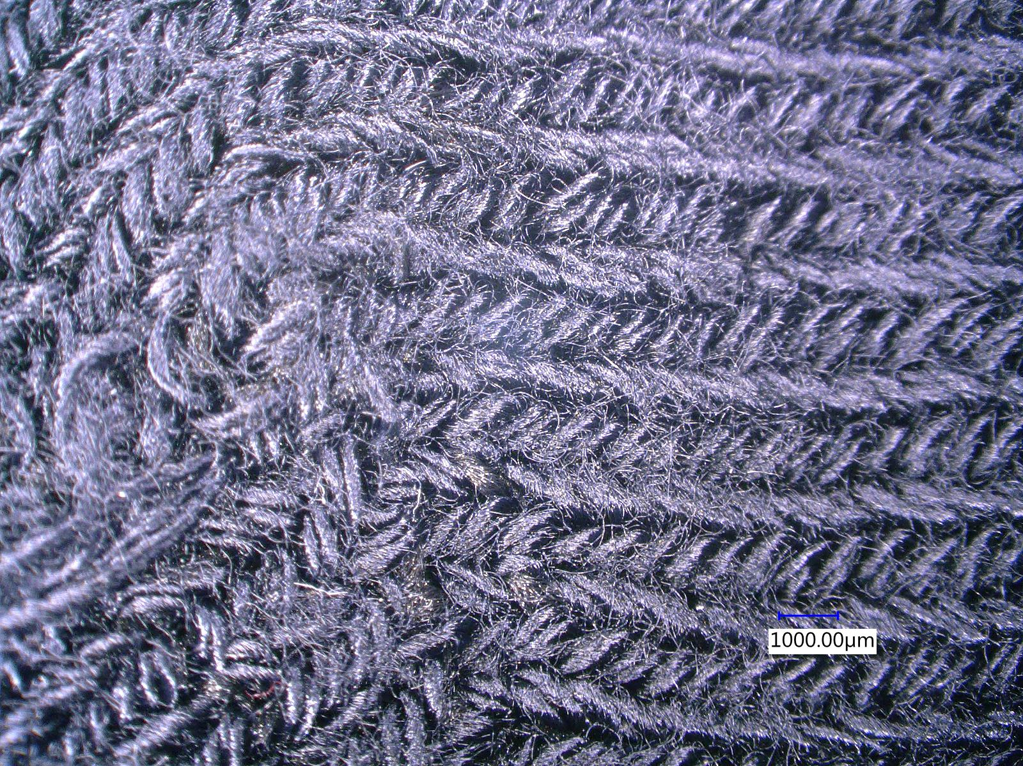
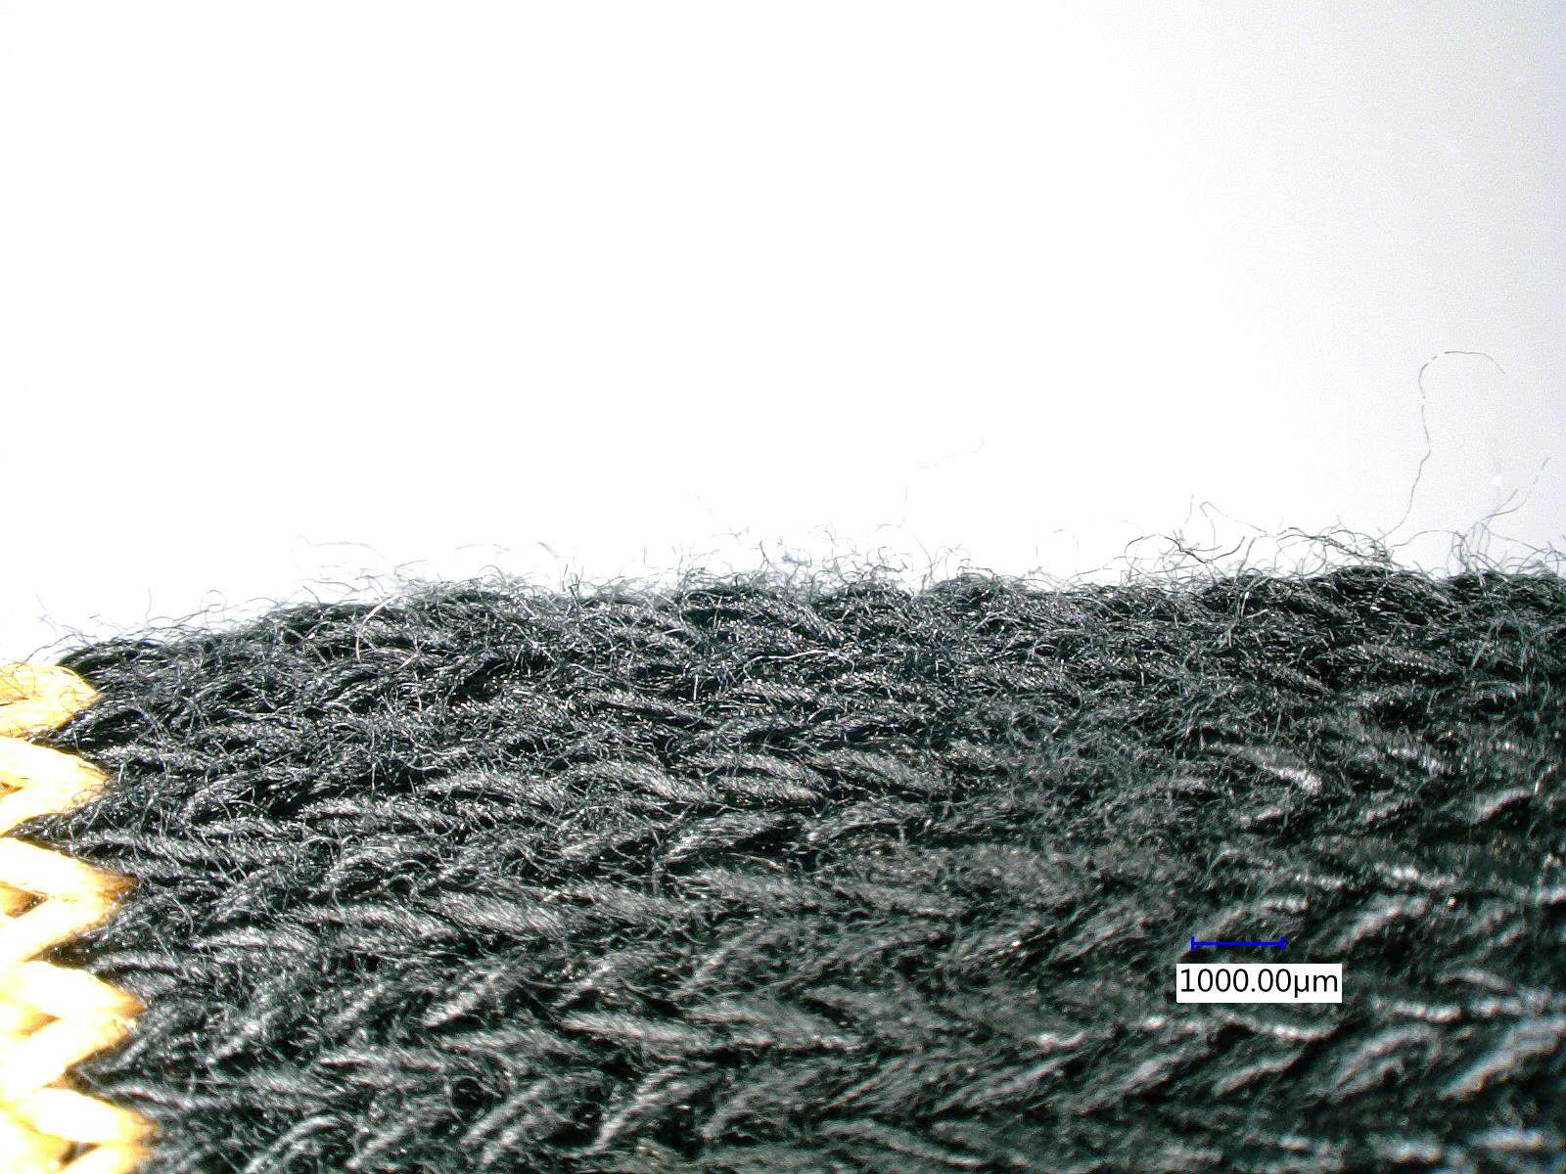
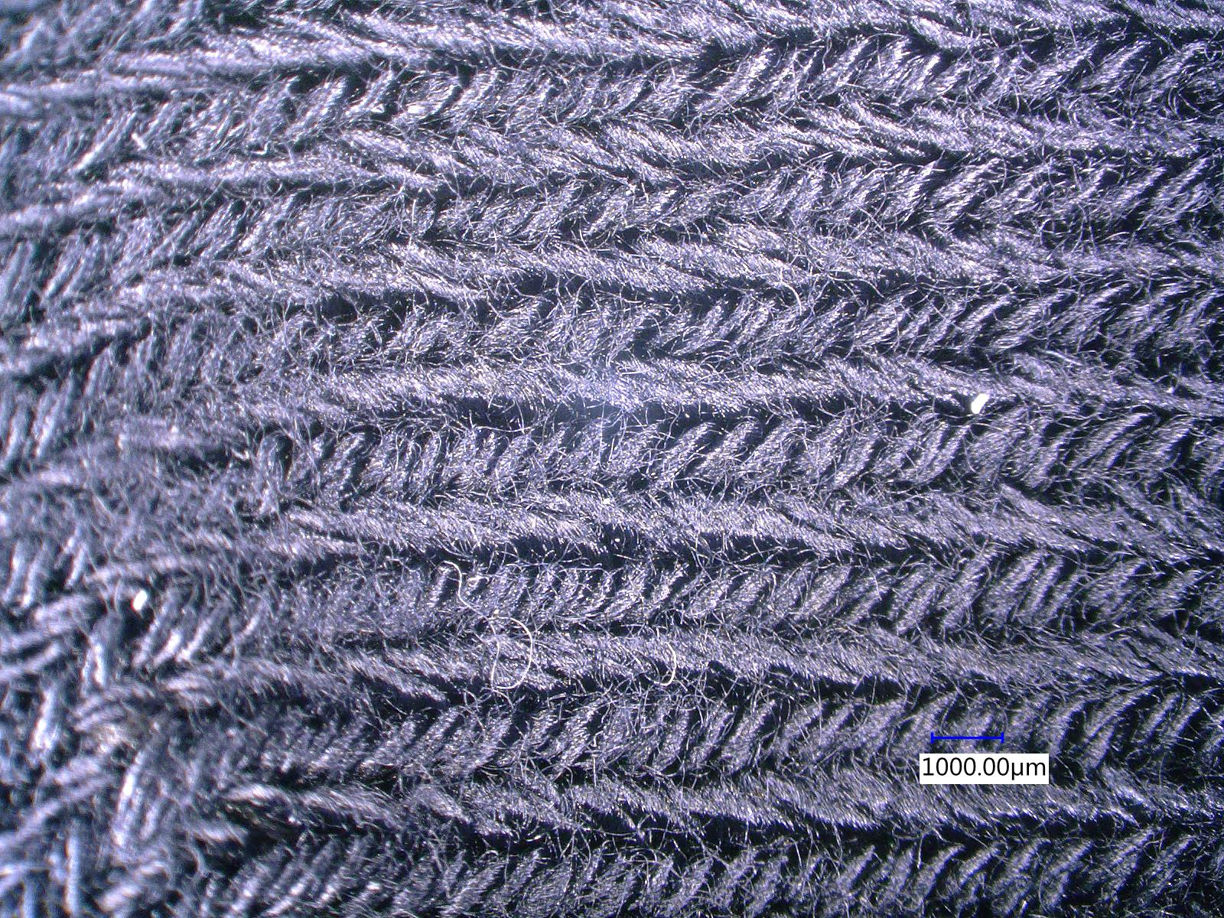
Microfiber Reduction Approach
Protects Filaments
Untreated Control
®
additive

Slide 32
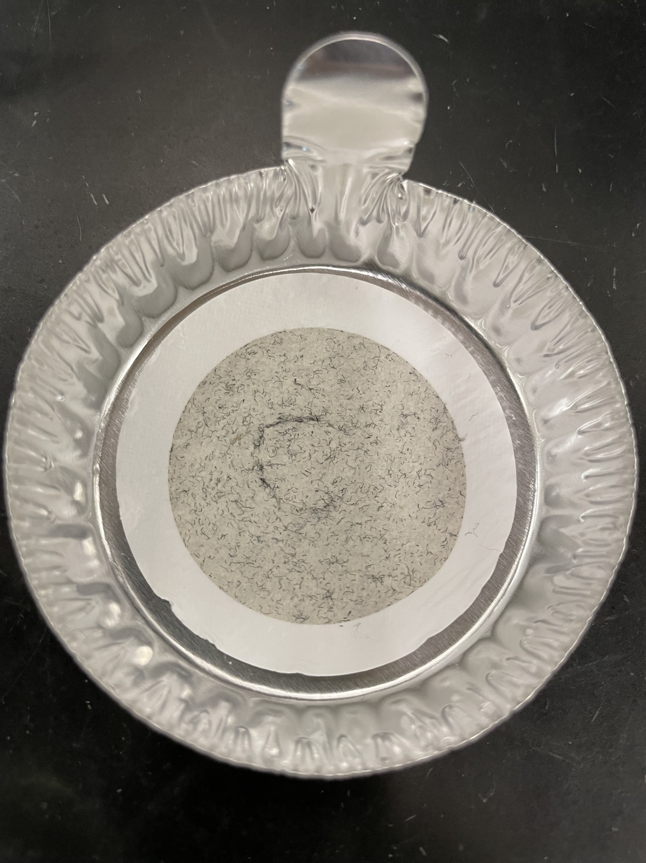
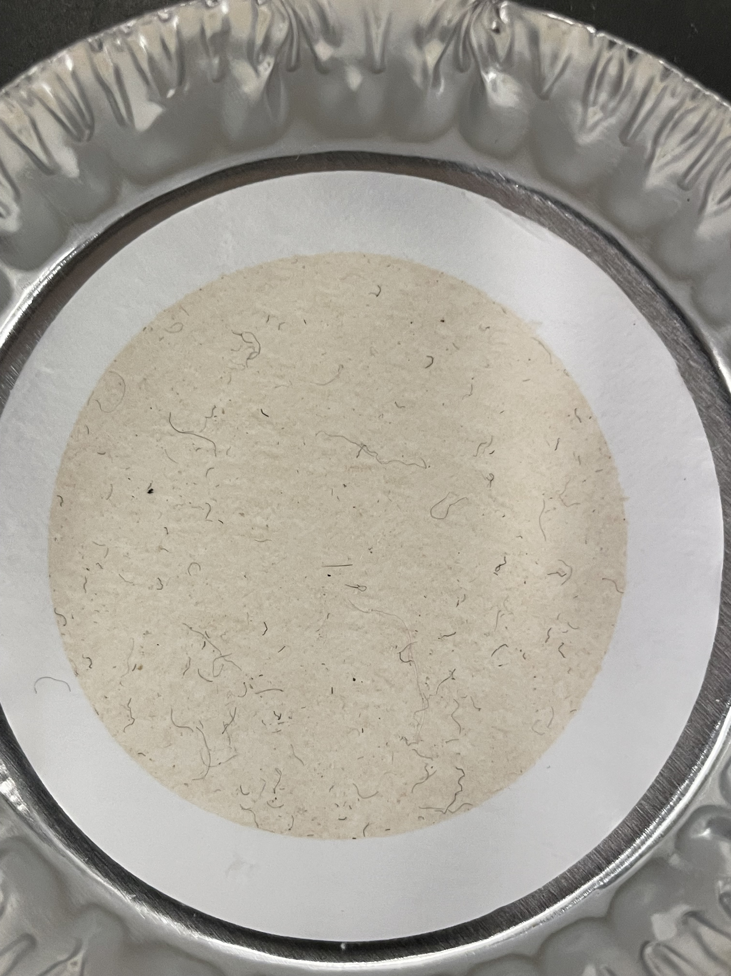
Microfiber Reduction Approach
Protects Filaments
®
82%
®
89%

Slide 33
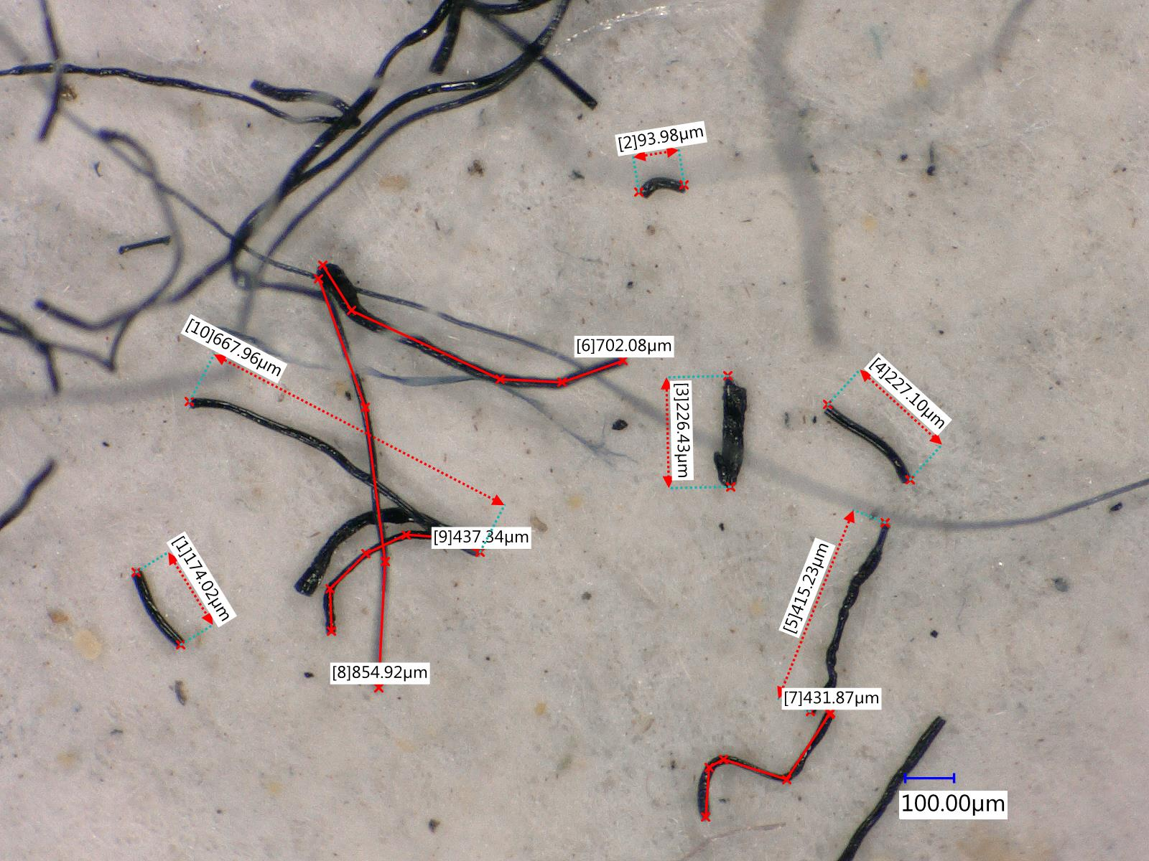
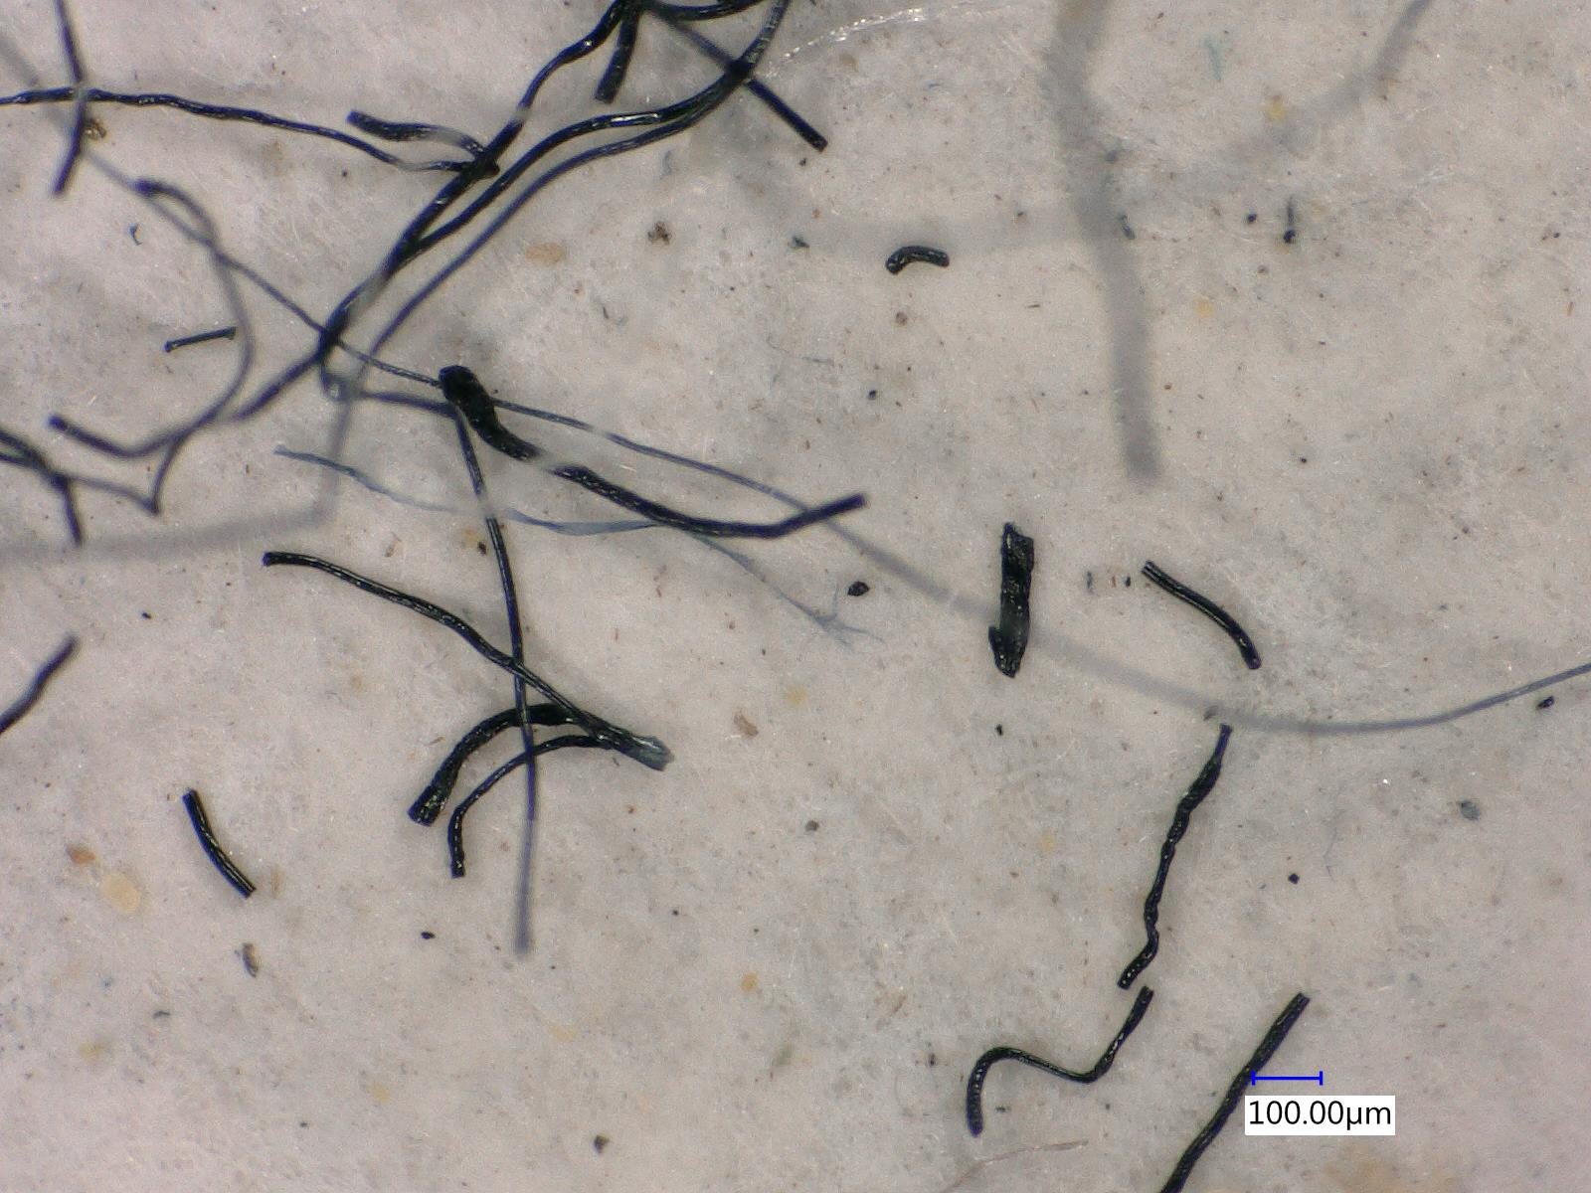
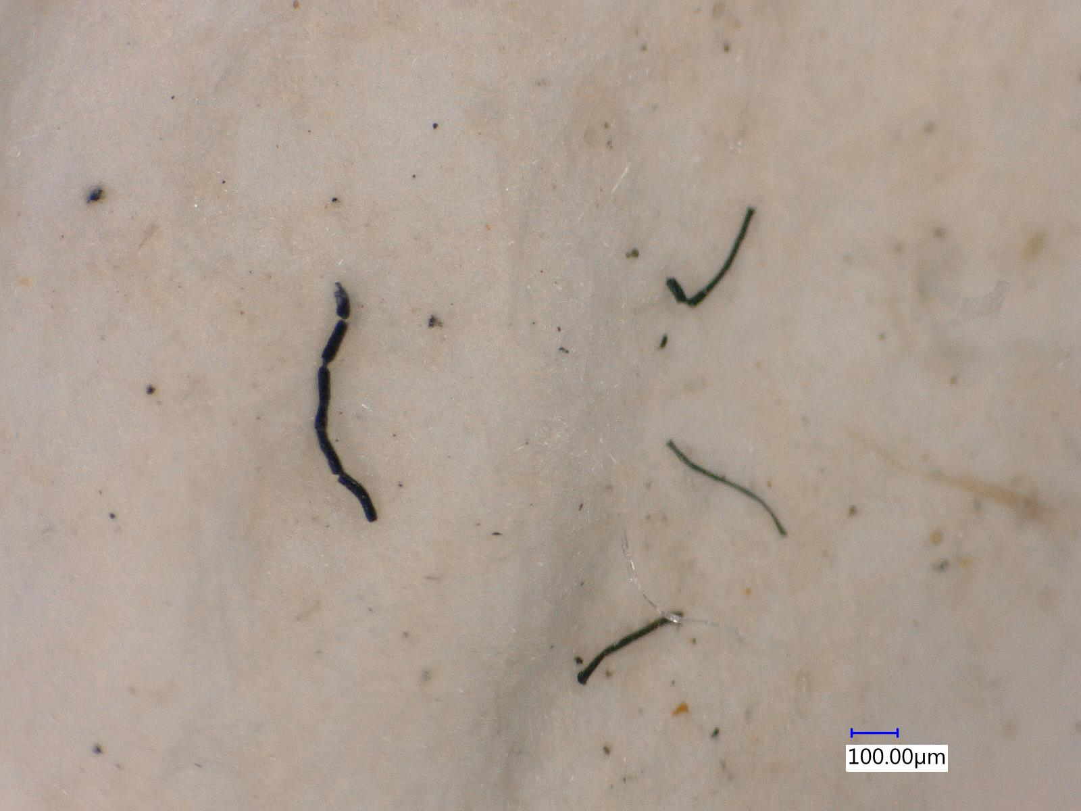
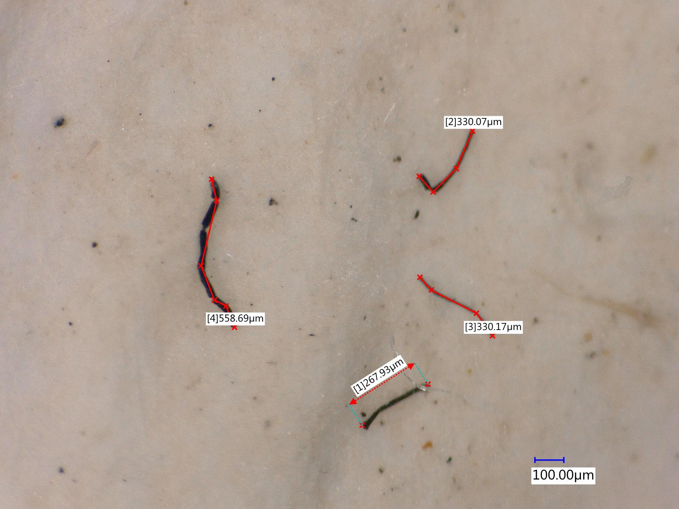
Microfiber Reduction Approach
Protects Filaments
Untreated Control
DryFast® Additive – 1% FOY
X150
X150
Clear differentiation in fiber counts
Differentiation in fiber fragment sizes difficult to discern

Slide 34
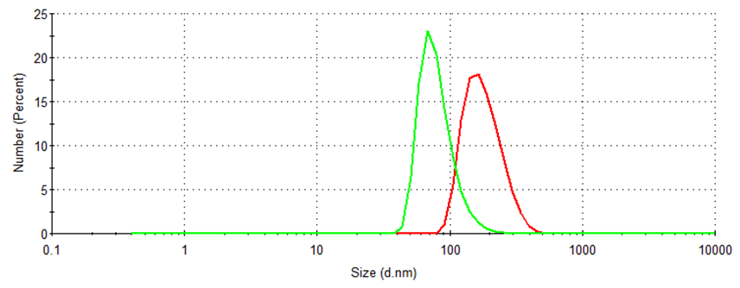
Microfiber Reduction Approach
Protects Filaments
Size Distribution by Number
25
_
_
x = 80.75 ± 25.76
x = 182.7 ± 60.28
20
15
Number (%)
10
5
0
0.1
1
10
100
1000
10000
Size (d. nm)
Untreated Control
DryFast® Additive – 1% FOY

Slide 35
Overview
v
  The Laundry Dilemma
  Goulston’s Background
  Goulston Tackling the Dilemma
  Wrap-Up

Slide 36

Future of DryFast® Additives
Sustainability
  DryFast ® additives pass OECD 302B in 21 days
  Achieved >80% sustainability of DryFast® products through bio-based and circular feedstocks
  Continued innovation to approach complete sustainability
Notes:
COD = ~2,000,000 mg O₂ /L

Slide 37
Summary
®
additives
Reduced
Energy
Consumption
Based on 300 average loads (675 kWh), 54-222 kWh can be saved annually
Reduced
Microplastics into
Water Systems
Based on 878 average tonnes, up to 781 tonnes can be prevented annually

Slide 38
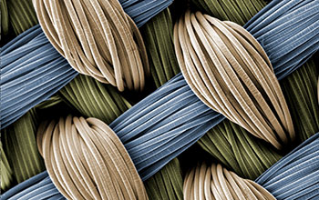
Final Thought
We are stronger together than we are alone
- Walter Payton
Source: National Science Foundation

Slide 39
Matt Bridges
R&D Manager – Filament mbridges@goulston.com
Thank you!
Darren Mond
Senior Research Associate
dmond@goulston.com

Slide 40
References
Boucher, J., & Friot, D. (2017). International Union for Conservation of Nature. Primary Microplastics in the Oceans: A Global Evaluation of Sources. Retrieved April 2023, from https://portals.iucn.org/library/sites/library/files/documents/2017-002-En.pdf
Desjardins, J. (2016, November 14). What uses the most energy in your home? Visual Capitalist. Retrieved April 2023, from https://www.visualcapitalist.com/what-uses-the-most-energy-home/
Electricity costs for 10 key household products. Arcadia. (2017, July 17). Retrieved April 2023, from https://blog.arcadia.com/electricity-costs-10-key-household-products/
Ellam, S. (2022, August 23). Laundry releases trillions of plastic microfibers into the Ocean. Ocean Wise. Retrieved April 2023, from https://www.ocean.org/blog/canadian-and-us-laundry-releases-trillions-of-plastic-microfibers-into-the-ocean/
Golden, J. S., Subramanian, V., Irizarri, G. M. A. U., White, P., & Meier, F. (2010, March 5). Energy and carbon impact from residential laundry in the United States. Taylor & Francis. Retrieved April 2023, from https://www.tandfonline.com/doi/full/10.1080/19438150903541873
Wait?!? how much time do people spend on laundry? The Folde. (n.d.). Retrieved April 2023, from https://www.thefolde.com/how-much-time-do-people-spend-on-laundry/#:~:text=Simple%20math%20shows%20that%20people,600%20per%20year%20on%20detergent.
Dirty-clothes. (2023). Freepik. Retrieved April 2023, from https://www.freepik.com/free-photos-vectors/dirty-clothes.
Fabric with water droplets. (2020). Ecotextile News. Retrieved April 2023, from https://www.ecotextile.com/2020033025889/dyes-chemicals-news/eu-likely-to-ban-c6-based-textile-coatings.html.
Weave_h. (2015). National Science Foundation. Retrieved April 2023, from https://www.nsf.gov/news/mmg/mmg_disp.jsp?med_id=76146.
Visual References

