Slide 1
Power Quality and Its Effect on Energy and Equipment
Bryce Krulic

Slide 2
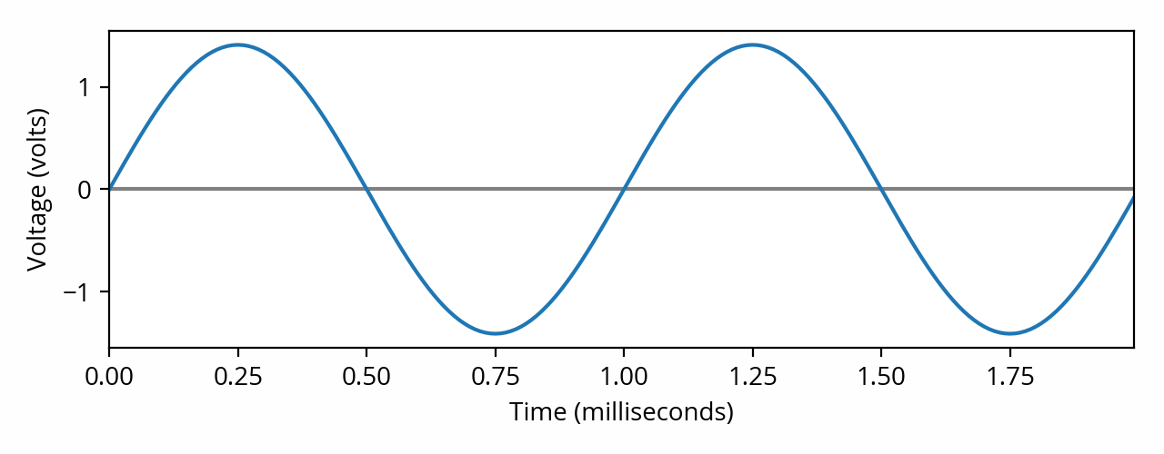
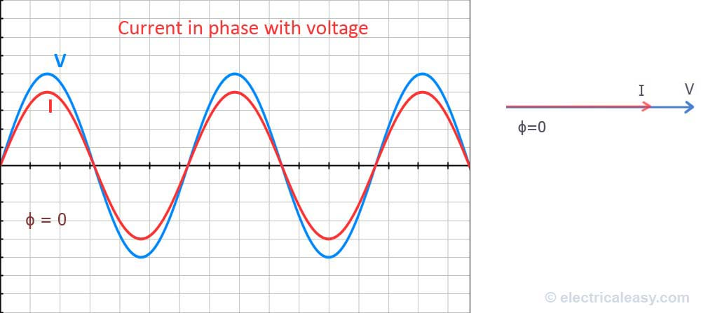
What is Power Quality?
The ability for an AC Power source and distribution network to maintain proper Voltage, wave form, frequency, and Power Factor per specifications
Sounds complicated? All we’re trying to do is make this look good:
And keep Current in line with Voltage:
CC BY

Slide 3
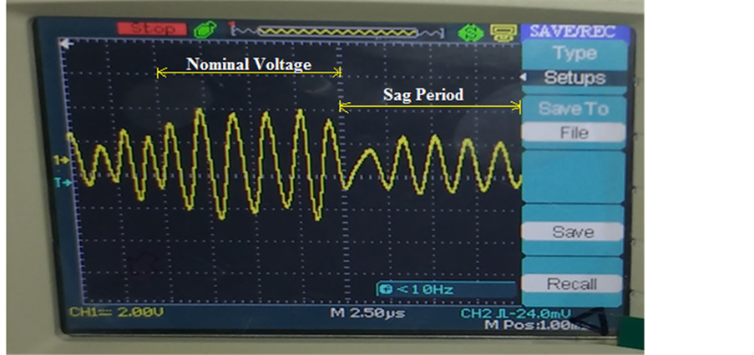
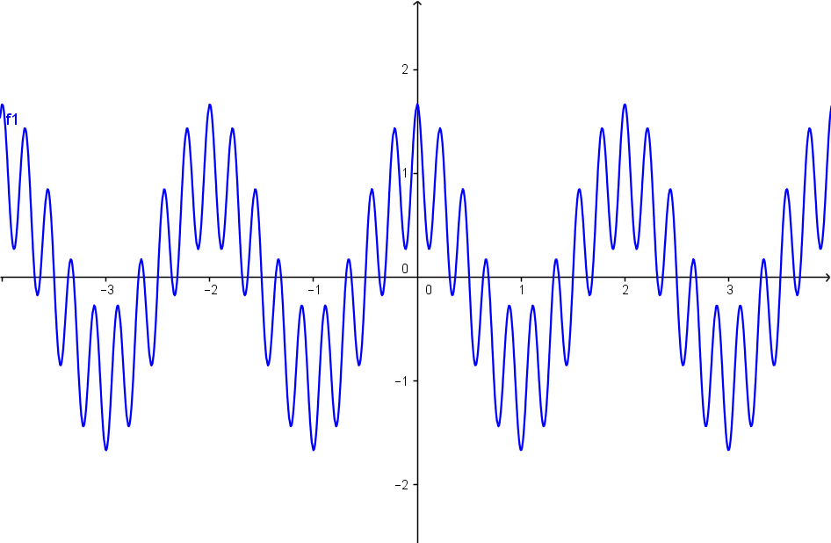
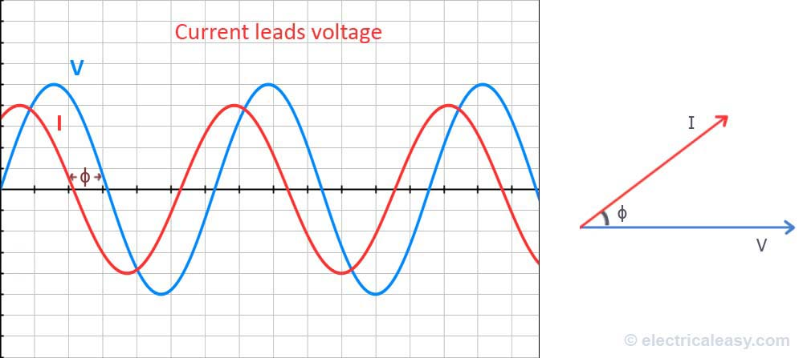
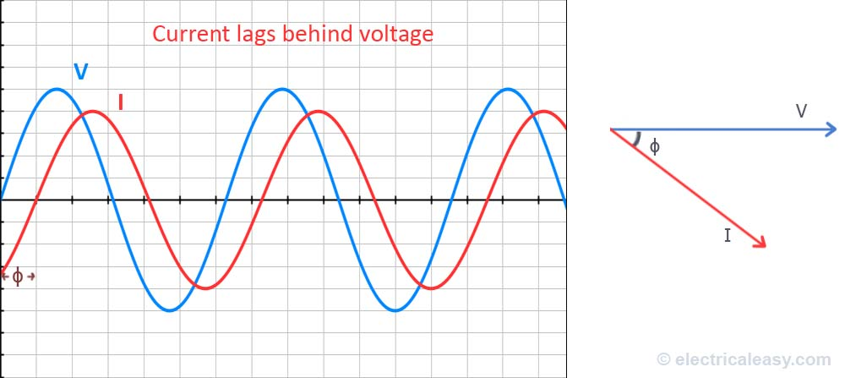
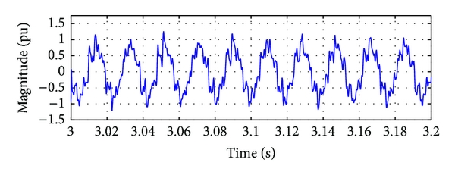
Examples of Poor Power Quality
CC BY
CC BY-SA

Slide 4
What is Impacted?
This is actually one of the largest concerns with renewable integration
As EV’s increase in popularity, back feed and reflected harmonics will be a major challenge to the grid, both on the utility side and customer metered side
Voltage sags, frequency shifts, and harmonics will need to be dealt with by the utilities, electrical distribution providers, and occasionally, the industrial sector
Utilities are going to seek greater efficiencies, and Power Factor is a low hanging fruit
According to the EPRI (Electrical Power Research Institute), large industrial facilities in North America lose $100B/Year due to PQ issues
Causes breakdown of equipment
PQ events can be silent killers; they can go undetected and contribute to equipment degradation
When we don’t have that perfect voltage curve and equipment draws a non-sinusoidal current wave:
Overheating
Malfunction
Pre-mature Aging
Thermal Stress on network devices such as Xfmrs and Feeder Lines
All of these lead to the loss of revenue, increased maintenance costs, and shorter equipment life

Slide 5
Power Quality
Key Focus Areas
Harmonics
Power Factor
Interruptions

Slide 6
Harmonic Filtration and Mitigation
Harmonic events can happen for brief periods of time
They can be intermittent and caused by other equipment and/or wiring in the plant
Can lead to power loss for several cycles; users may think that utility is having an outage or surge

Slide 7
Harmonic Filtration and Mitigation
Harmonics can be consistent due to current distortion and non-linear loads (which are typically electronics and LED lighting)
Can lead to overheating, premature aging, and shutdowns
Power utility company may start to notice before you do. This waveform gets reflected back to its feed/source

Slide 8
What are the solutions?
If these symptoms are seen, a power study should be commissioned by a local service.
Power graphs are often recorded over weeks and months.
Upon initial inspection after a few weeks, culprit equipment and scenarios can be prognosed to rule those sources in or out.
If culprits cannot be eliminated or reduced, then harmonic filters or fully automatic active filters will be recommended for installation.
For dedicated equipment needing low distortion, a power conditioner can be used

Slide 9
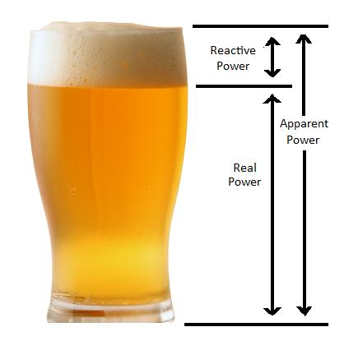
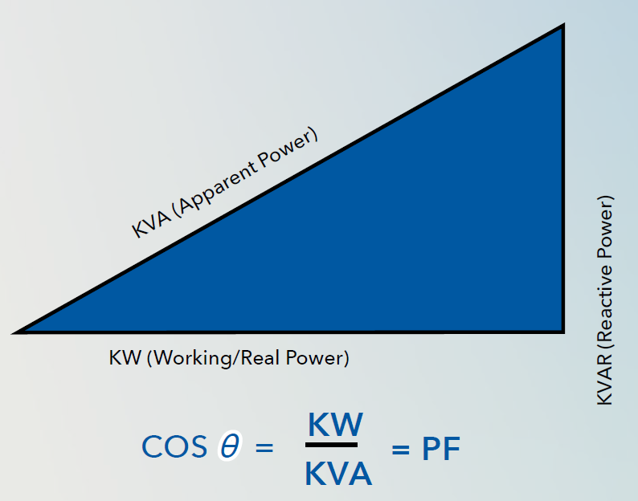
Power Factor, what is it?
PF = Real Power in (kW) / Apparent Power (kVA)
Power that is wasted is called Reactive Power or kVAR
What causes this Reactive Power?
Large inductive Loads – Motors, think 10 to 500 HP motors running hydraulics, compressors, spinners, etc.
Unbalanced loads on 3-phases
Faulty or aging electric equipment
Incorrect Wiring

Slide 10
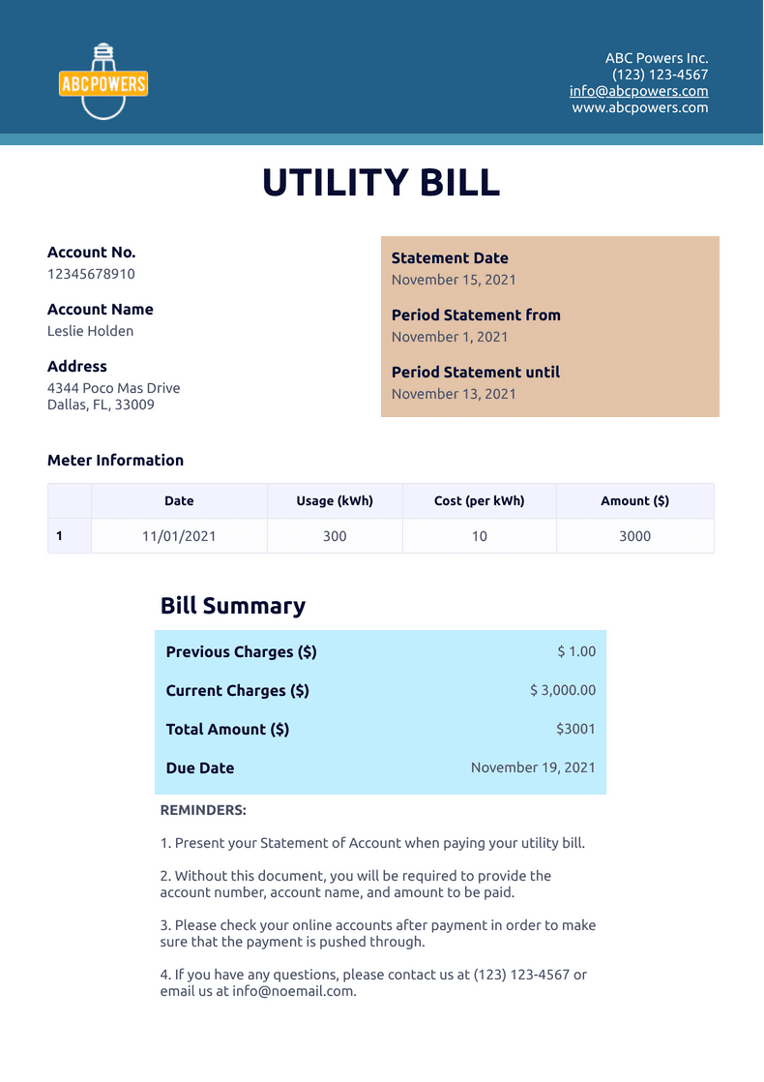
What are the symptoms of Low Power Factor?
Increase in utility bill
Utility bill penalties for low power factor or incentives to achieve higher power factor
At this time, Utilities and their cooperatives in GA and the Carolinas are not penalizing or incentivizing against low power factor, but this could change
However, FL, AL and Northeastern and Mid-western utilities are penalizing for low power factor
Recall the power study that we might need for Harmonics? Low power factor can be discovered there, as well.

Slide 11
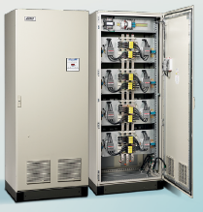
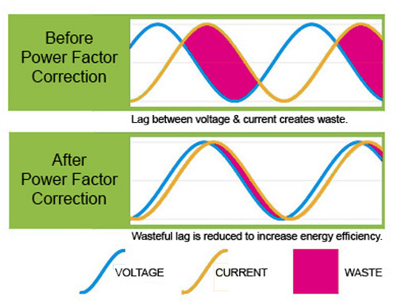
What are the solutions?
In order to increase the power factor, and reduce reactive power, install switched capacitor banks
Depending on the utility, corrections from 0.8 pF to > 0.9 pF can save 10’s of $1000/YR
ROI example would be $40K investment in capacitor banks yielding a 6-to-18-month payoff; monthly savings of $8K, annual $96K
At this time, your electrical utility may not be looking at this, and they might be more focused on load shedding and peak power incentives
Take a look at power bills and talk to your electrical utility rep for awareness and solutions

Slide 12
So how about Power Interruptions and Outages?
Voltage sags caused by startup of other heavy equipment
Breakers inadvertently tripping
Poor connections to terminal blocks, bus plugs, and terminal lugs
Indirectly by conditions already discussed; chain reaction of power events
Utility outages

Slide 13
What are the costs of interruptions?
Equipment downtime; be aware that equipment is not ‘down’ for just the brief 2 or 3 seconds of the outage
PLC’s (Programmable Logic Controllers) and servers will need time to boot back up, could take several minutes to hours
Material in play may go to waste, as the process is unfinished and needs to be restarted
Safety—if it’s interrupted and not running, then lives could possibly be put in danger
Excess wear on heavy equipment and machinery

Slide 14
Solutions for interruptions?
Find the source of the outage and address appropriately, potentially with a power study
If the outage is unforeseeable, i.e. intermittent breaker or utility outage, then the solution is a UPS system—Uninterruptible Power Supply
UPS = Bank of batteries that inverters their DC Power to AC Power. The energy stored is considered “reserve” or “standby” which differentiates it from Grid/Solar/Peak Power energy storage
Can bridge the gap of transfer to and from a Generator / ATS for longer term auxiliary power for continued operations of the plant; UPS is typically a more localized solution (i.e. panel)

Slide 15
Key take aways
When equipment is overheating and/or not operating properly and all other system attributes are running under specification, ask your electricians if a power study is warranted.
Check your power utility bills for plants outside of GA, SC, and NC. See if there is a penalty for low power factor or an incentive to get higher power factor. Rarely, the bill may obscure this, so consult your power utility rep just in case.
If equipment is shutting down or you’re having unforeseen outages; operations cannot be interrupted by electronic rebooting from power up, consider utilizing UPS systems to cover the interruption gaps. UPS’s work great in tandem with generators.

Slide 16
Questions?

