Slide 1
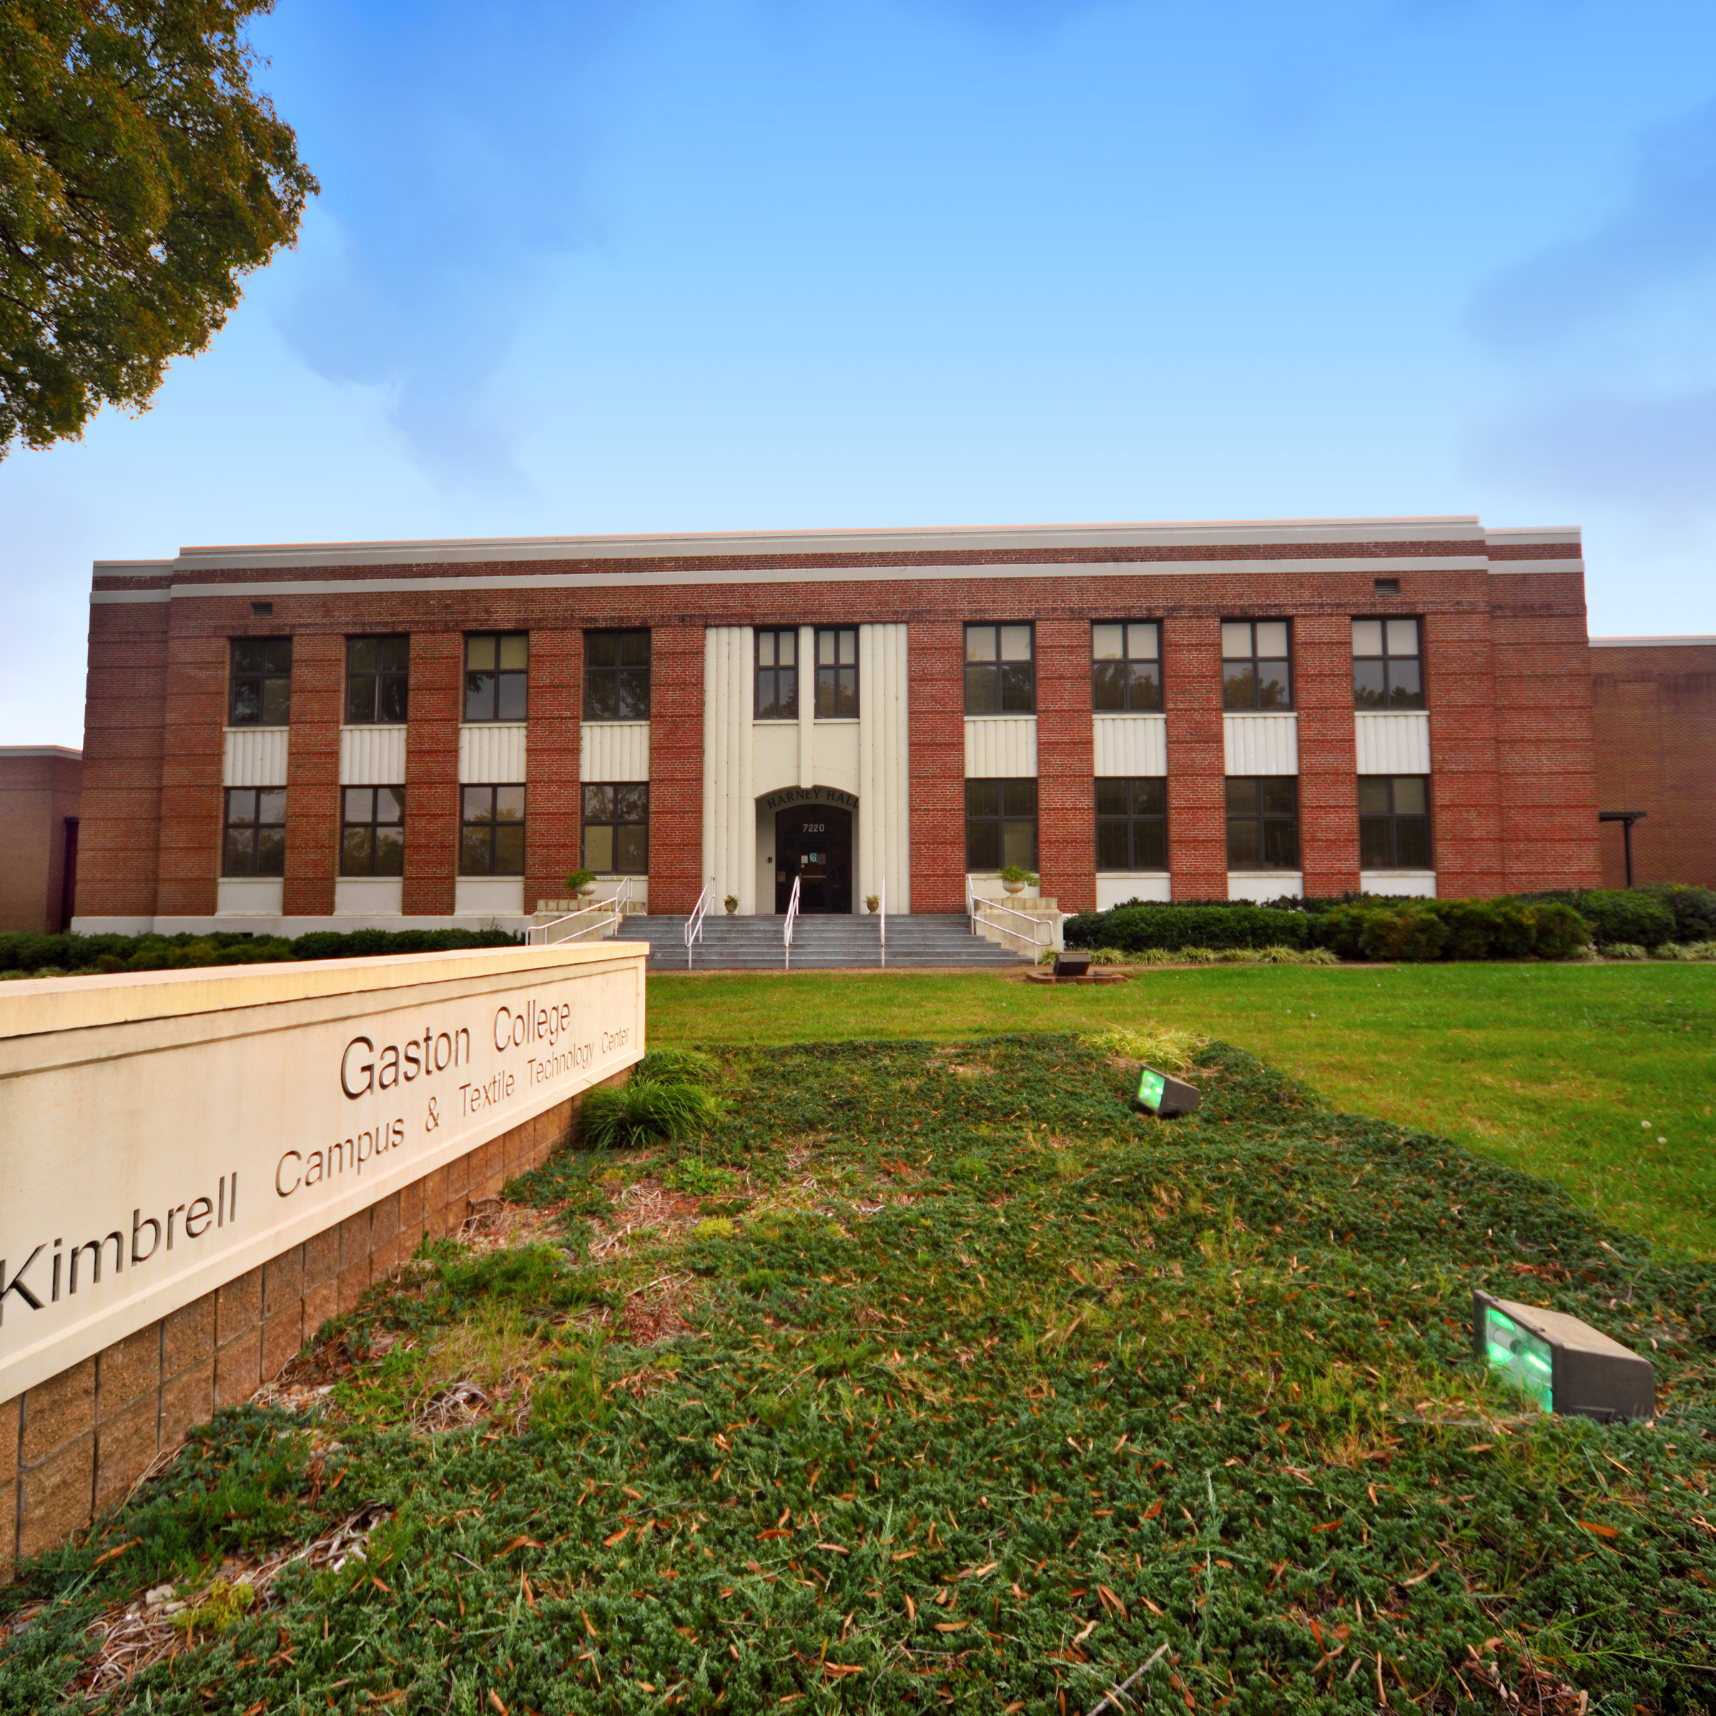

Filling in the Gap: Textile Training & Education
Jasmine Cox
Director of Textile Technology Programs & Business Innovation

Slide 2
Bridging the Gap
4-Year Textile Related Instruction (University)
Textile Industry
Retiring Labor force/ Open Jobs

Slide 3

What is missing?

Slide 4
Bridging the Gap
4-Year Textile Related Instruction (University)
Textile Industry
Retiring Labor force/ Open Jobs
K-12 Outreach
Summer Camps
CTE Courses/
High School & College Dual Enrollment
Textile Academy/Rapid Workforce Training
Certificates/AAS in Textile Technology

Slide 5


A Career and College Promise Program
Get a HEAD START on Your Future
While Still in High School

Slide 6
WHAT IS COLLEGE NOW?
Tuition-Free
Accelerate your future
Dual Enrollment
College Now is a dual enrollment program that lets high school juniors and seniors take college level classes at Gaston College TUITION FREE while still in high school. Cost savings range from hundreds to thousands of dollars!!
College Now
Notes:
*talk to counselor re: associated costs

Slide 7

COMPARE THE SAVINGS
You can potentially save thousands of dollars through the College Now Program!
NC Public Universities Approximate Savings | ≅ $9,000 - $18,000
NC Private Universities Approximate Savings | ≅ $22,000 - $44,000

Slide 8
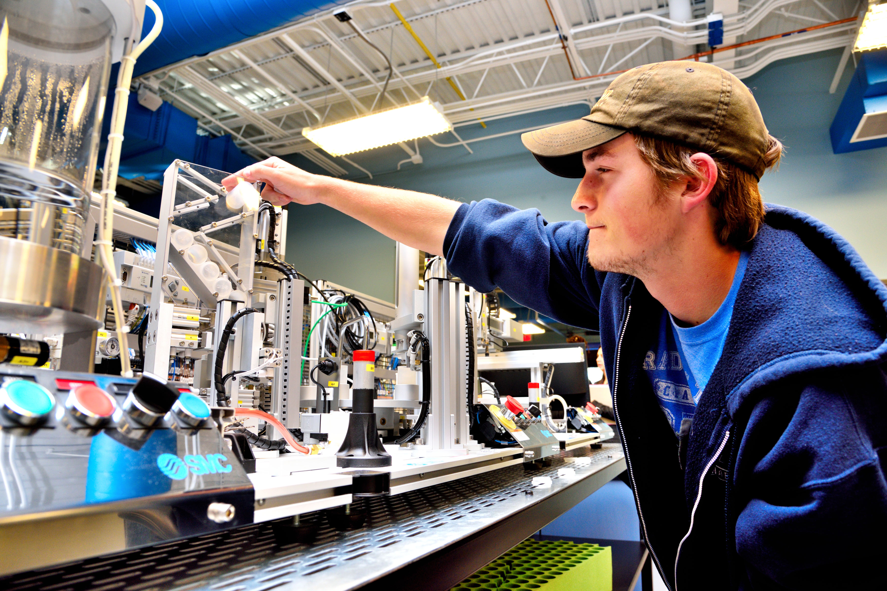
The Textile Academy
A Rapid Workforce Solution

Slide 9
What is the textile academy ?
Administered by the Gaston College Continuing Education Department and driven by the U.S. Textile Industry, the Textile Academy is:
  a 4-6 week customizable training program offering program graduates stackable credentials from Gaston College, OSHA 10 Hour and Forklift Certification, course credit to continue into the Textile Technology AAS degree program and soft skills needed to be a successful employee in Textile Manufacturing
  Comprised of various tracks that represent areas of the textile and apparel supply chain, all tracks begin with the textile fundamentals certification
  Professional Development Tool for current college students preparing for entering the workforce

Slide 10
Stackable Credential Model
Textile Fundamentals
Fall 2022
Quality/Testing
Fabric Formation
Yarn Development
Student Professional Development

Slide 11




Champion Companies

Slide 12
If your organization would like to become a champion company and help plan the initial cohort for the textile academy, please contact me: cox.jasmine@gaston.edu

Slide 13


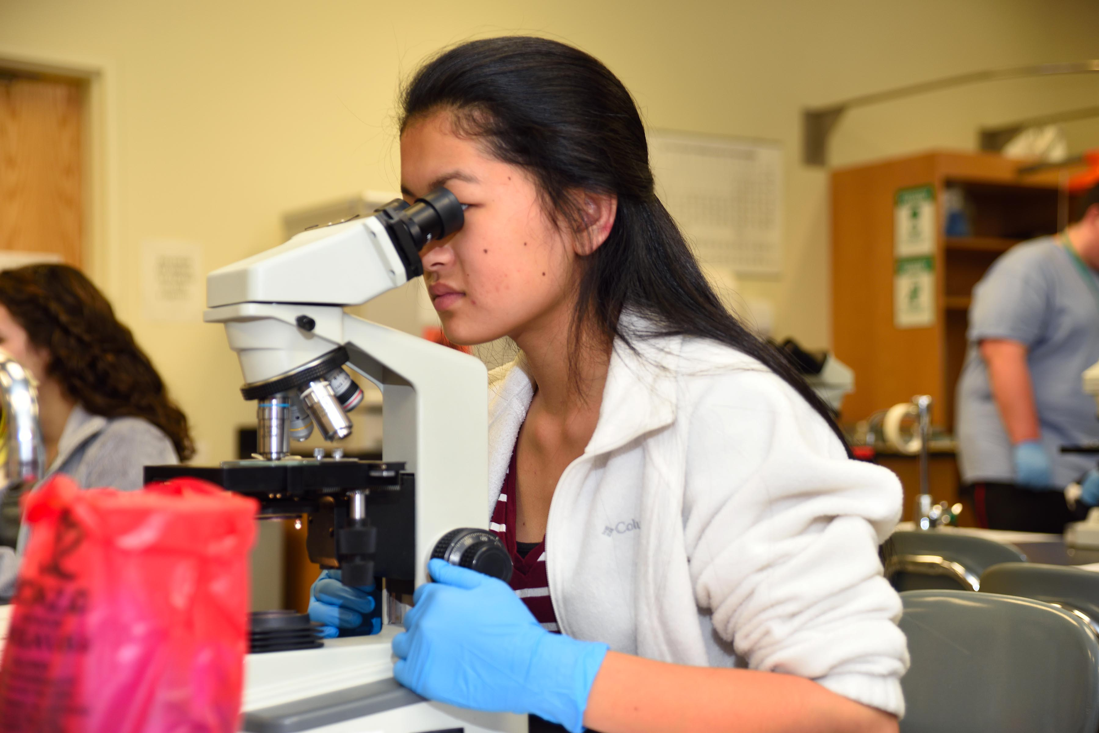
Gaston College Textile Technology Program
Certificates
Textile Technology Degree Tracks
Fashion Design and Fundamentals
Textile Technology Fundamentals
Design
General
Technician/Technical
Management
Transfer

Slide 14

Textile Technology Design & Management Track
Perfect program for students with a creative background
Understand the development, distribution and marketing of textiles
Learn fundamental computer aided design, drawing, and garment construction principles
Take fundamental business and management courses
Complete work base learning/co-op
Perfect track for students with an interest in entrepreneurship

Slide 15
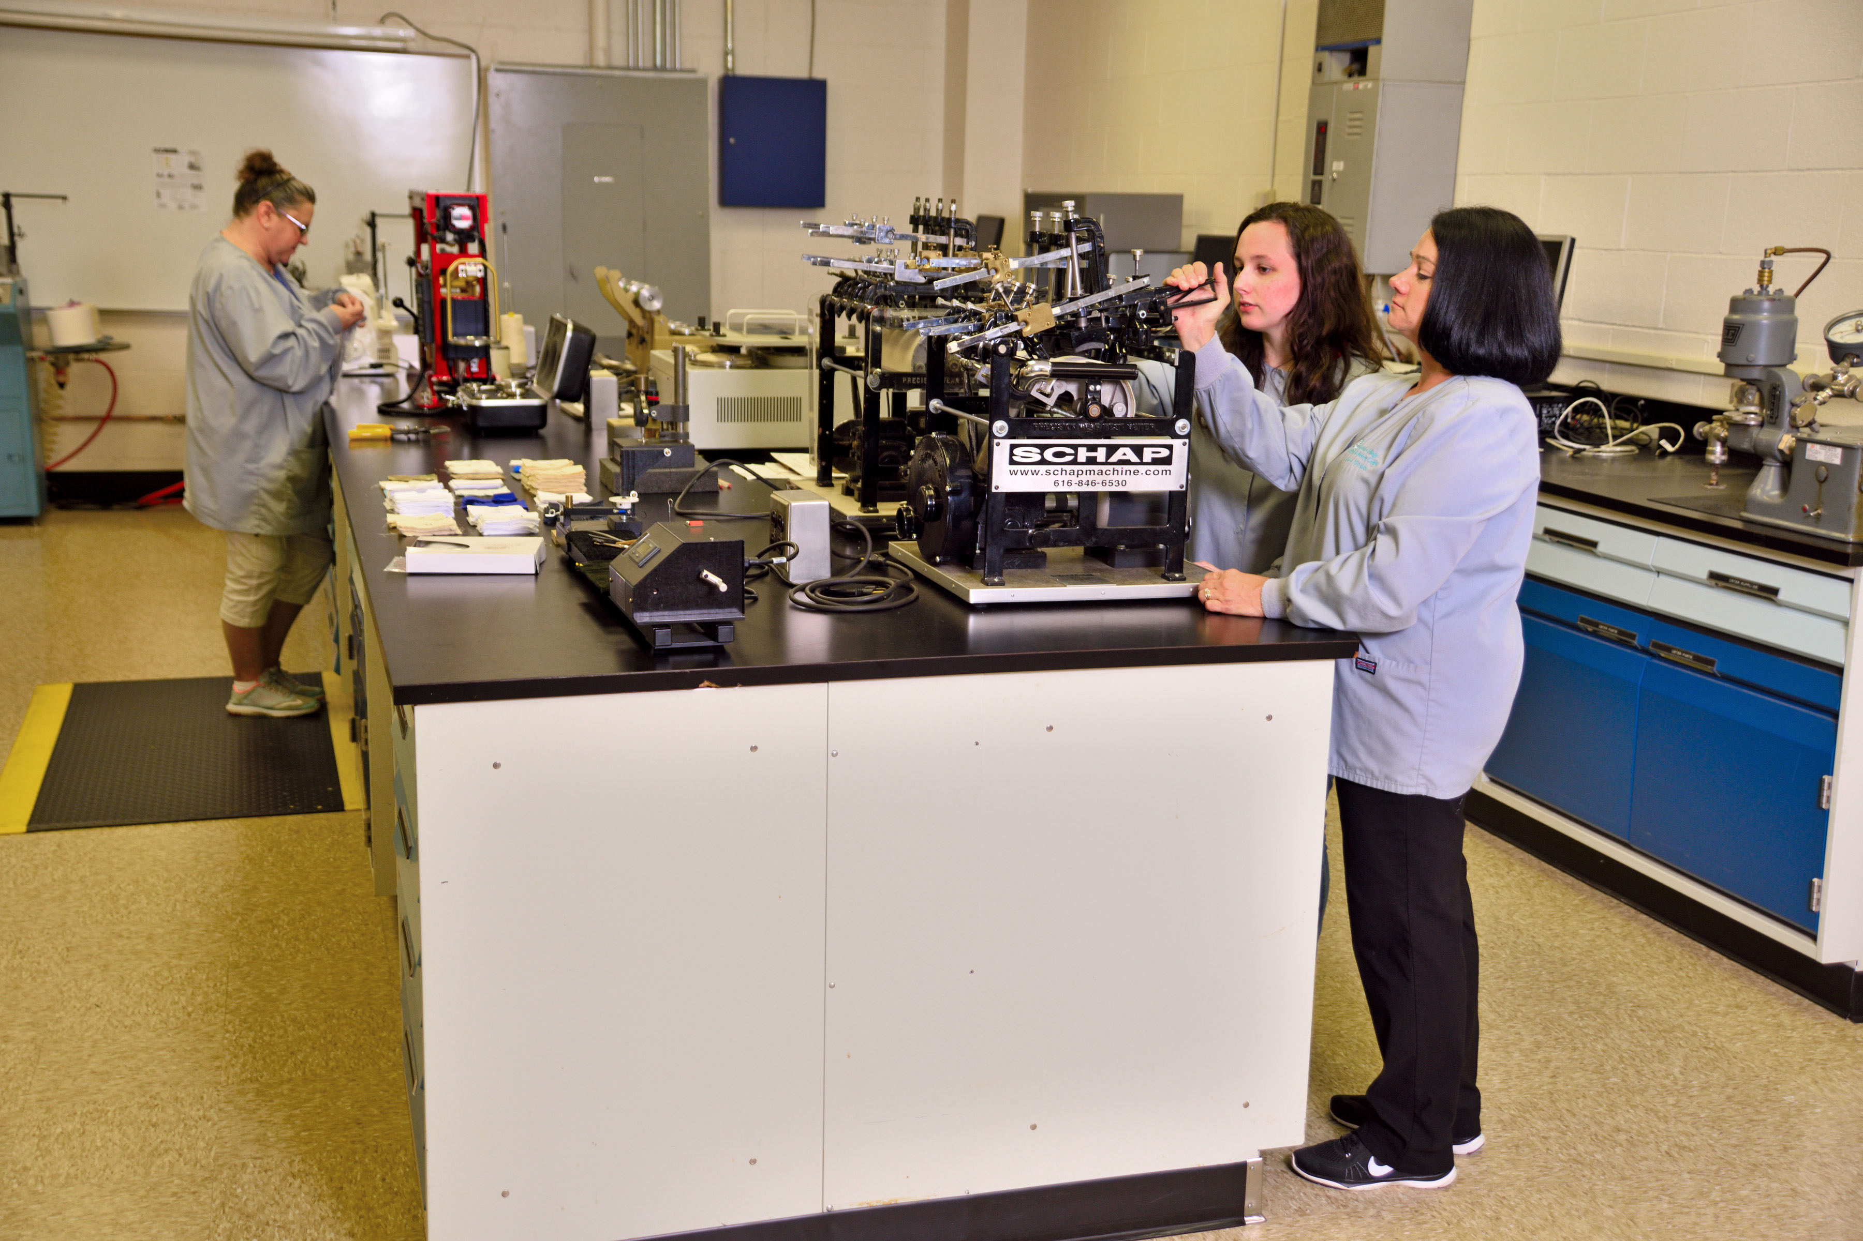
Textile Technology Technical & General Track
Perfect Track for students with STEM interests
Understand the processes for advanced material development and manufacturing principles
Potentially earn two degrees (Associate of Science and AAS in Textile Technology)
Learn fundamental machining and engineering principles
Complete work base learning/co-op with local industry
Transferrable to the NC State University Wilson College of Textiles

Slide 16



Current Transfer Programs

Slide 17
We are currently hiring adjunct professors with a diverse textile background who also have design/apparel experience. If you are interested in applying please contact me: cox.jasmine@gaston.edu

Slide 18
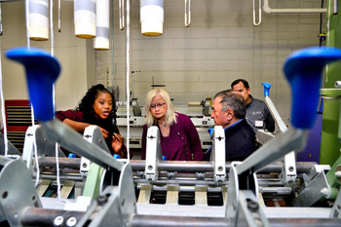
Thank you!
Cox.jasmine@gaston.edu

